Slide 1
Data Ethics:
Understanding Big Data, Algorithmic Bias, and Research Ethics
ENG 7360 Topics in Rhetoric
Prof. Mya Poe Fall 2022
Taught By:
Feel free to ask questions at any point during the presentation!

Slide 2
Workshop Goals
Recognize how data are being used in society as well as how algorithms impact and shape our daily lives.
Explore how notions of privacy, security, and agency are being reshaped and redefined through big data, algorithms, and policy.
Understand the ways in which technology reflects cultural, social, and political biases.
Engage with critical rethinking of everyday practices related to data collection and use.
Explore ways of interpreting and effectively utilizing data-based evidence in written arguments.
Explore how these questions and methods are influencing how [social scientists/policy-makers/etc.] do research and practice their craft.
Slides, handouts, and data available at https://bit.ly/3Q991EG

Slide 3
What is “Big Data”?
Notes:
Ask students to turn and talk to create a working definition for “big data”
IF ON ZOOM - have students all share their definitions in the chat, read definitions aloud or paraphrase them, if time permits and definitions are insufficiently clear ask (no more than 2-4) students follow up question on their definition (“tell me more about what you’re thinking…”)
IF IN PERSON - invite 3-5 students to share their definition or their partners’ definition

Slide 4
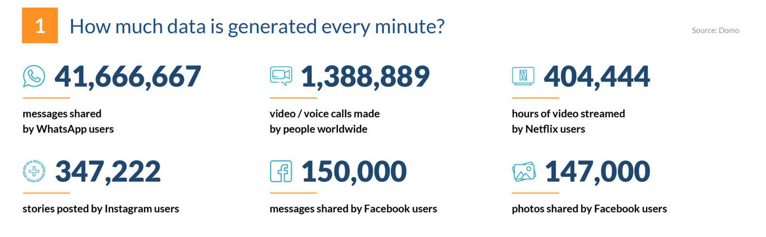
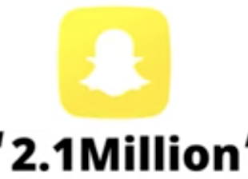
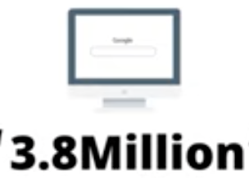

Big Data is here (and it’s getting bigger)
Notes:
Instructor: give the students a moment to gloss the slide, then click to animate the three additional fly-in data/minute stats.
[CLICK] Not to mention 2.1 million snaps shared, [CLICK] 3.8 million google search queries, [CLICK] 4.5 million videos are watched on youtube, and 188 million emails are sent around the world.
This is a LOT of data generated each minute!
These numbers are from 2019 2 years ago - imagine how they will increase and new categories will be added as time goes on. Source: Andre, L. 2021. "53 Important Statistics About How Much Data Is Created Every Day". Finance Online.
https://financesonline.com/how-much-data-is-created-every-day/
Questions to consider:
How does this much data get collected, stored and analyzed? And by whom?
How is this volume and kind of data collection similar to and different from the ‘old’ ways of collecting data, as in archives and databases?
If you were a historian 30 years from now, where would you start to learn about life as a college student in 2021, when so much of our lives are lived in these digital spaces?
Andre, L. 2021. "53 Important Statistics About How Much Data Is Created Every Day". Finance Online.
https://financesonline.com/how-much-data-is-created-every-day/

Slide 5
Defining “Big Data”
Companies, governments, and other groups collect vast amounts of data from vast numbers of users and analyze that data quickly for a variety of purposes, including advertising, marketing, surveillance, building consumer/political profiles, etc.
The goal of big data is to predict individual user behavior based on patterns from the user as well as patterns from “similar” users (based on demographic information, behavioral patterns, etc).
We’re living in an era of “surveillance capitalism” — our information can be considered a valuable product.
Notes:
If an entity knows what ten people with similar characteristics to yours do, it can predict what you might do
The four components of big data are: volume, variety, velocity, and veracity. Big data collects large information at rapid speeds to categorize behaviors and patterns, adjusting categories along the way.
First, big data is, as its name suggests, very large in volume, with thousands, millions, or even billions of observations across a massive population.
The second component of big data is variety. Big data is often collected from many different sources and combined together, providing new and more comprehensive datasets.
The third is velocity. Big data is usually collected in real-time as a side product of a different process without people necessarily knowing that they are being observed. For example, transportation big data could be the result of people across Boston swiping their CharlieCard to board busses and trains.
The fourth is veracity. We should always be wary of the truthfulness and generalizability of big data because it is not necessarily representative. We need to understand the limits of what big data is and what it is telling us.
Sometimes “value” is discussed as a fifth “V” of Big Data. The value of Big Data is the reason a company, government, or other organization has to collect, analyze, and use it - in other words, what VALUE will the use of Big Data bring to the organization (more users? higher profits? better products? more equitable practices?)

Slide 6
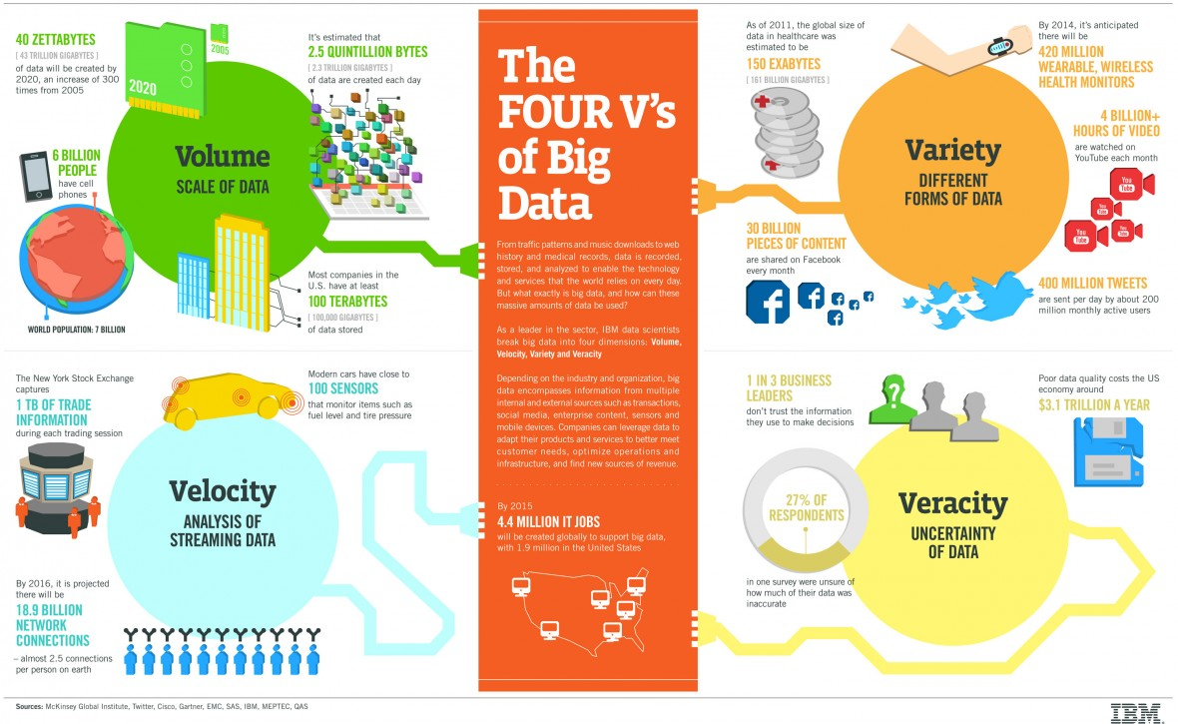
Notes:
The four components of big data are: volume, variety, velocity, and veracity. Big data collects large information at rapid speeds to categorize behaviors and patterns, adjusting categories along the way.
First, big data is, as its name suggests, very large in volume, with thousands, millions, or even billions of observations across a massive population.
The second component of big data is variety. Big data is often collected from many different sources and combined together, providing new and more comprehensive datasets.
The third is velocity. Big data is usually collected in real-time as a side product of a different process without people necessarily knowing that they are being observed. For example, transportation big data could be the result of people across Boston swiping their CharlieCard to board busses and trains.
The fourth is veracity. We should always be wary of the truthfulness and generalizability of big data because it is not necessarily representative. We need to understand the limits of what big data is and what it is telling us.
Sometimes “Value” is discussed as a fifth “V” of Big Data. The value of Big Data is the reason a company, government, or other organization has to collect, analyze, and use it - in other words, what VALUE will the use of Big Data bring to the organization (more users? higher profits? better products? more equitable practices?)

Slide 7
Why should we care about Big Data?
Big data is omnipresent—its sources include: digitized records, internet activity, and even sensors from the physical environment.
Big data is often privately owned and it is hard to ensure oversight over how it is developed, used, and controlled.
The scale of big data enables those who use, develop, and control it to magnify their influence.
Big data can be used to (inadvertently or purposefully) entrench stereotypes or reproduce results that may harm certain communities.
Big data also raises ethics questions about access, power, autonomy, anonymity, privacy, discrimination, and bias.
Notes:
Point 1:
Big data is characterized by its scale - the data itself is very long, meaning big data sources have many different data points to analyze at quick speeds.
Big data sources include digitized records, social media/internet activity, or sensors from the physical environment. For example, smart city sensors, cameras that use facial recognition software, fitness trackers, speed cameras, and more.
Point 2:
Big data is often privately owned and sold between data collectors, vendors, advertisers, and other corporations.
An example of big data usage and trading: an insurance company purchasing social media activity from facebook in order to make specific insurance sales decisions. Or maybe a mobile gaming company purchasing activity from Youtube or Instagram to determine who their target players might be. If you’ve ever received advertisements for weird mobile games, they for some reason have categorized you as a potential customer.
Point 3: read the slide
Point 4: read the slide
How are experts and researchers using big data in the context of the COVID-19 pandemic? Have you read any articles that shared results from a big data analysis? What different types of data did the article use?
Are large-scale monitoring and surveillance systems a breach of individuals' privacy? In a pandemic, is the tradeoff between (some level of) privacy and the health/safety of a community/nation worth considering?
Big data is characterized by its scale - the data itself is very long, meaning big data sources have many different data points to analyze at quick speeds.
Big data sources include digitized records, social media/internet activity, or sensors from the physical environment. For example, smart city sensors, the cameras in China that use facial recognition software, fitness trackers, speed cameras, and more.
Big data is often privately owned and sold between data collectors, vendors, advertisers, and other corporations.
An example of big data usage and trading: an insurance company purchasing social media activity from facebook in order to make specific insurance sales decisions. Or maybe a mobile gaming company purchasing activity from Youtube or Instagram to determine who their target players might be. If you’ve ever received advertisements for weird mobile games, they for some reason have categorized you as a potential customer.
For example, you searched for a new mattress and looked at few reviews on YouTube. Soon your Facebook, YouTube, and other platforms will start showing you ads for mattresses! This happens because companies purchase activity data from YouTube/Instagram/Facebook etc. and they have categorized you as a potential customer.
Big data comes from many different sources. These include digitized records, social media and internet activity, and sensors from the physical environment, to name only a few examples. Tracking devices that are used include computers, phones, Smart city sensors, the facial recognition softwares, fitness trackers, speed cameras, COVID test and vaccine trackers etc.
We should care because Big data is often privately owned by corporations or governments and is frequently traded and sold between vendors, collectors, advertisers, and the government. For example, insurance companies often purchase data from other collectors, like social media providers, on customers in order to make insurance sales decisions.

Slide 8
Online Presence
&
Data Privacy

Slide 9
Questions to consider:
How are we being represented online?
Where is data about our lives coming from, and how is it being collected?
Who is using our data and for what purposes?
How might our data be used in the future?
How does “big data” impact our daily lives?

Slide 10
How does Big Data impact our daily lives?
Entertainment media (music, shows, movies)
Healthcare and medical services
Shopping and marketing Travel and transportation
Education and Employment News and Information
Public policy and safety
Notes:
Instructor: For each point on the slide, ask the class for an example [use the chat], then confirm/correct the answer and expand on it:
Alternative: Give 2-3 mins to students in the classroom to discuss with the student sitting next to them. Then go through each topic and ask students to respond.
Entertainment Media:
“Companies like Spotify and Pandora rely heavily on big data, tracking what music you choose and like to redirect your experience in real-time”
“In 2016, big data led Netflix to create more original content like its hit Stranger Things, contributing to a major change in the company’s direction and in your experience with Netflix”
Healthcare:
“The use of electronic data can enable doctors, hospitals, and clinics to more efficiently track your history… your data is also being analyzed along with the health histories of many others to enable medical professionals to track diseases, determine the effectiveness of treatments, etc.”
Health trackers like fitbits also inform health research
Shopping and Marketing:
“When you make a purchase on a site like Amazon, that information is then compared to a pool of data about other consumers who purchased the same item. Those comparisons allow the retailer to make predictions about other items that might interest you. These items then will appear as suggestions in various ways as you browse the retailer’s sites.”
Travel and Transportation:
GPS and better sequencing of traffic signals and public transit schedules
“Big data also has revolutionized the airline industry at virtually all levels. … Fares are set by automated data collection and analysis, and schedules are created based on predictions made from the collection of big data.”
Education and Employment - here’s where it starts to get tricky!
“Many colleges and universities now rely on statistical programs designed to identify and attract students who enable the institutions to meet internal goals….Admissions decisions often include work with data designed to predict success for both students and educational institutions.”
News and Information - still tricky!
“Trends in big data populate your various media timelines with stories determined to be of higher importance or of particular interest to you. Automated data processes determine the most talked about stories and often push them to the front of both news aggregators and social media sites”
Public Policy and Safety - and now it’s gotten REALLY tricky!
“ Stockpiles of data gathered from government sources, surveillance systems, emergency vehicle GPS tracking, and fire and smoke detectors help fire departments prepare to respond more quickly and effectively to fire emergencies.”
“Networks of computers, cameras, and mobile devices track incidents in real-time so police can be dispatched more efficiently and effectively. Police departments and law enforcement agencies around the world increasingly work to be proactive rather than simply responding to crime after the fact.”
From this Michigan Tech article

Slide 11

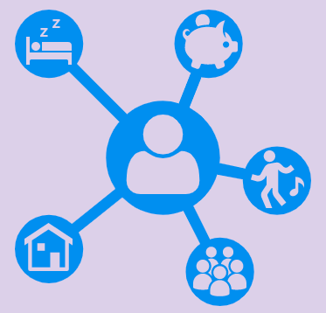
Who Collects Our Data? How is it Used?
If our digital lives constantly (and silently) produce data, how is that data used, and how can we stay aware of it?
Notes:
Our online activity leaves leaves a data footprint. As we browse a website, it can collect data on our identities, our hobbies, our addresses, our social circles, our habits, etc., all without our active awareness. What do websites and the institutions that run those sites do with our data? Often, that remains unknown to us.
Sometimes, that data is used by an algorithm to sell us products or show us content that might better “fit” the tastes implied by our online profile; this is called targeted advertising. If you've ever searched for something and then seen an ad for that same product on a website, you've experienced this kind of data tracking.
But how else can algorithms use our data, and just as important, how can algorithms—with our data running through them—determine the things that happen to us, both online and in the real world?

Slide 12





Social Media Preferences & Targeted Ads
You are categorized by your series of behaviors and identity markers.
Social media sites collect, store, and sell information about you, so that you get better targeted ads and your newsfeed is tailored to your categories. Some social media sites that do this:
Notes:
Facebook collects all your activity: what you write in your profile information, where you click and go online, whom you talk to, what you say in messenger, and more.
Data is collected to create a profile that describes who you are and how advertisers may use that information to better target you with personalized advertisements. Plus, ever notice how the same people and ideas pop up on your newsfeed? That’s because Facebook’s algorithm can categorize your interests in terms of politics, social interests, and more and make sure your newsfeed knows you more.
Same with YouTube, Instagram, and more! You are categorized by your series of behaviors and identity markers. For example, young women who watch YouTube beauty gurus are more likely to receive makeup advertisements, and young men who are interested in video game content on YouTube are more likely to recommendations for alt-right videos.

Slide 13
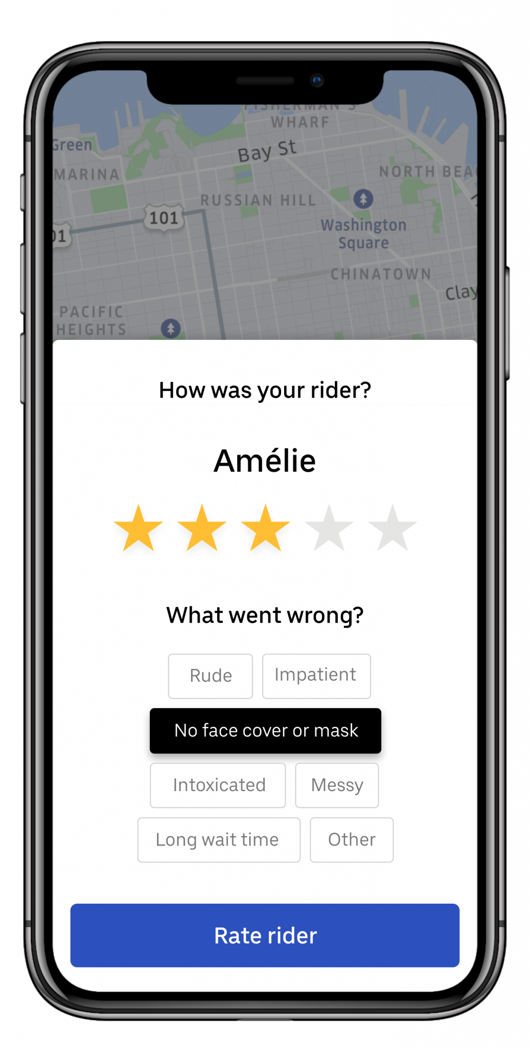
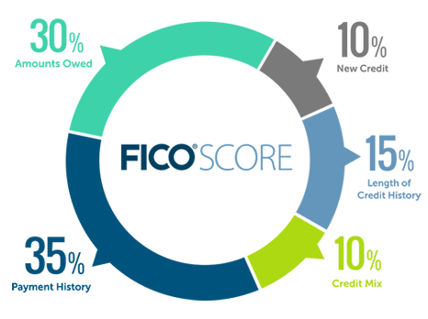
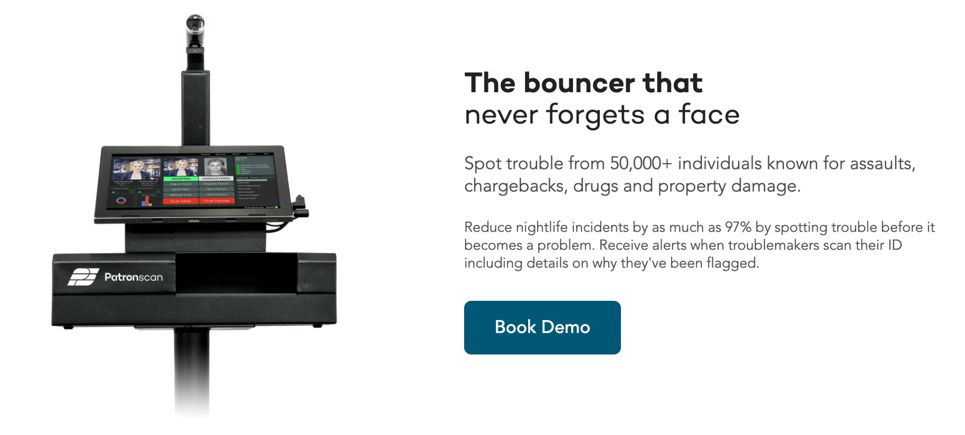
Discussion: America’s Social Credit Systems
What social credit systems exist in the United States today? How do they impact our lives?
Notes:
Most of these surveillance systems are established and enforced by private companies instead of the government. Some of these systems relate to monetizing our online activities and collecting our data for target advertising. If you've ever searched for something and then seen an ad for that same product on a website, then you've experienced this kind of data tracking.
You all may have used a service delivery app and then rated the service provider, let it be Uber, Airbnb, or Yelp. In this case, you have provided data points to a rating system that impacts the credibility of the service provider.
One can argue that these ratings and preference tracking is part of contemporary business models and encourage healthy competition and good customer service. However, these impacts can go beyond advertising and improving our web experiences. For example: Credit Scoring System! Credit scores don't just impact the rates you get when you want to borrow money, but can also be used to determine whether you are able to rent an apartment or if your job application gets selected for an interview. Do you know your credit score and how is it calculated? You can actually improve your credit scores if know their assessment method. I recommend you to investigate this on your own.
I am not sure if you have heard about a surveillance solution that is provided by a company called PatronScan. It sells patron ID management system to bars, restaurants, hotels and maintains a list of “objectionable customers” that the member bars and restaurants can use to exclude certain visitors who may have been unruly or troublesome.

Slide 14

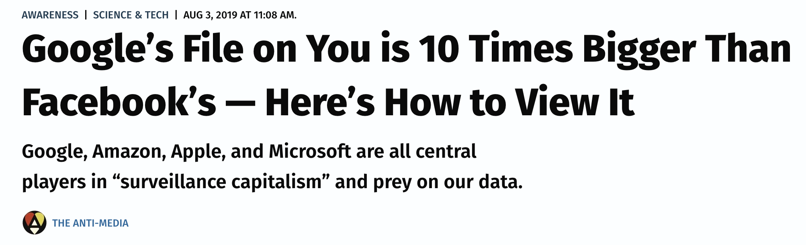
Example: If you have location services turned on for Google (like if you use Google maps), Google can track your every move. Go to:
https://www.google.com/maps/timeline
Notes:
DO NOT demo the link - next slide has a screen shot - encourage students to follow the link if curious
Google Maps can track your every move and also recognize how you’re moving (by train, car, walking, plane, etc.). Google knows the places you’ve visited, where you frequent most, and more. If you have your location services on, that’s why you might get notifications from Google asking you to review particular restaurants or shops.
Of course, Google maps isn’t the end for Google’s data collection. Google knows your search engine patterns, your behaviors online, and more.

Slide 15
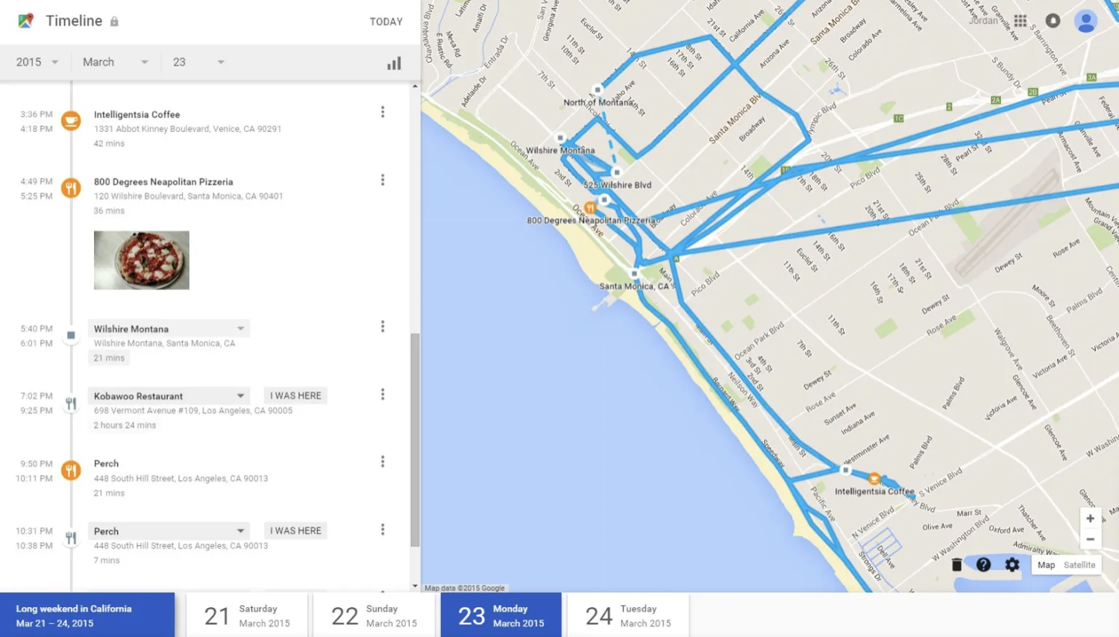
Example of Google Maps’ Timeline:
Check out an early (2015) Venturebeat article about “freaky” Google Map ‘Your Timeline’ feature here

Slide 16

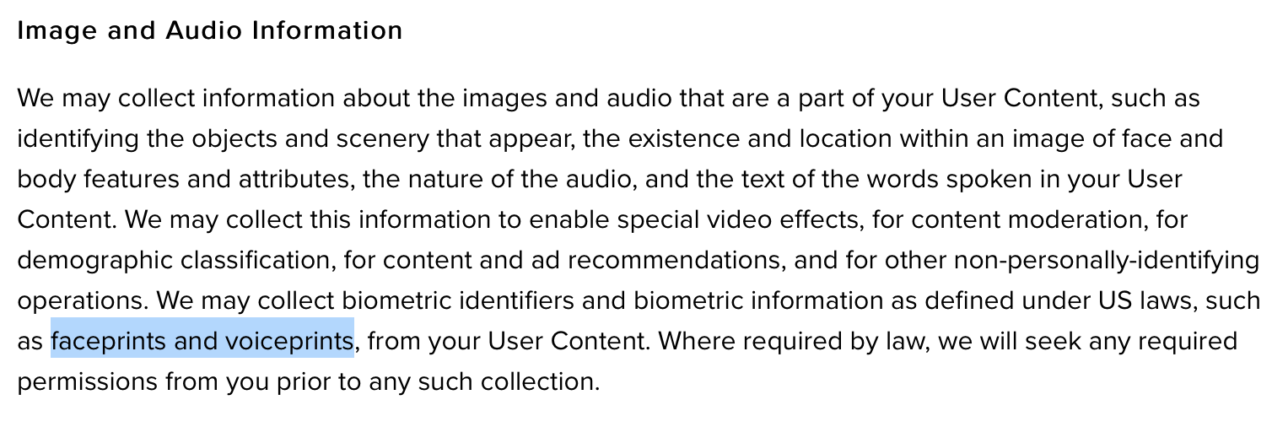
Notes:
According to TikTok, the platform automatically collects a variety of information from you when you use the platform, including your IP address, geolocation-related data, browsing/search history, Cookies, and “unique device identifiers”
What’s new about TikTok and what distinguishes it from other social media apps is that it collects much more granular, more intimate bits of information on its users, including faceprints and voiceprints that can, hypothetically speaking, provide more insights into human psychology and emotions.
It also collects your image and audio information to a very great detail. Moreover, their recent updated terms and conditions states that they “may collect biometric identifiers and biometric information, as defined under US laws, such as faceprints and voiceprints.” They have not clarified as to how they will use users biometric information. Moreover, there is no federal law regulating collection and use of biometric information. Only a handful of states have biometric privacy laws: Illinois, California, New York, Texas and Washington.
https://time.com/6071773/tiktok-faceprints-voiceprints-privacy/

Slide 17
How Are We Being Tracked?
Most websites collect data on their visitors. Some monetize that data in a “data exploitation market,” monetizing their users’ personal information.
Blacklight is a website privacy investigation tool developed by The Markup, a nonprofit publication that investigates data misconduct. You can use it to scan and reveal the specific user-tracking technologies on any site.
Use Blacklight now!
Notes:
“Data exploitation market” is a term I took straight from Julia Angwin during her speaking event. From that same event, Angwin said that The Markup “collects as little personal info about readers as possible, and does not monetize it,” saying in so many words that the choice of whether or not to monetize and contribute to this data market is an expressly deliberate one made by the owners of websites and their institutions.

Slide 18
Online Presence & Data Privacy Discussion

Slide 19
Downloading Your Data & Tightening your Privacy
Facebook: Settings > Your Facebook Information > Download your Information
Google: https://support.google.com/accounts/answer/3024190?hl=en
Instagram: Settings > Privacy and Security > Data download/Request Download
Want to make your life more private? Follow this “DIY Guide to Feminist Cybersecurity” https://hackblossom.org/cybersecurity/
Notes:
Now that you know how your data is being collected, you can choose to review this data and also tighten your privacy settings.
Most collected data is not publically available, but there are ways to collect your own data from the data collection corporations. You can also scrape data from various sources like Twitter via their APIs. An API is an application programming interface, which allows different forms of software to ‘talk to each other’ according to certain data formats and conventions. Just to let you know, Google’s file is fairly large and in JSON format, so it might be hard to parse.
Instagram also lets you see your most recent advertisements by going to Settings then Ads and Ad Activity. You can see the ads you are most likely to receive.
Social media content is all individualized and personalized for you. The algorithms know you well.
If you are interested in a DIY cybersecurity, if you care about your privacy, anonymity, and controlling your information as much as possible, follow these guidelines!
Browser Extensions, mobile privacy, public WiFi, tracking, VPNs, two-factor authentication, etc.

Slide 20
Algorithms and Bias

Slide 21
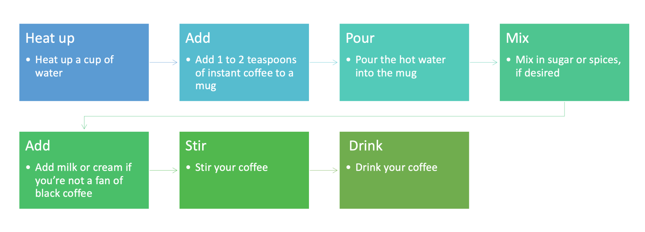
What is an algorithm?
Have you used algorithms in your everyday life? Any examples?
Notes:
Ask a student if they have used algorithms in their daily life. Prompt: what they do in the morning to get ready. How do you make coffee? That's an algorithm!
Show the diagram and read the steps
Every person works with elementary algorithms every day. We all follow a set of pre-defined actions or rules to achieve our desired results. For example, think about the specific steps you follow to make coffee. That's also an algorithm!

Slide 22
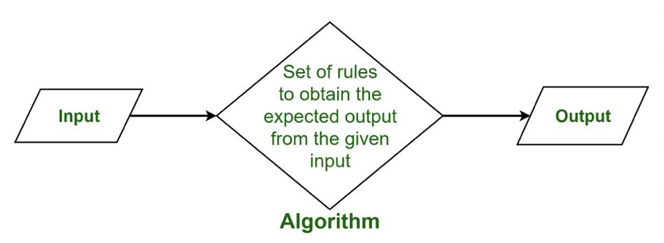
Defining Algorithms
An algorithm is a set of instructions, usually for computers to interpret and follow.
“Machine learning” happens when an algorithm tells a computer to make decisions based on a set of patterns derived from data, instead of following specific predetermined instructions.
Notes:
There is usually an input, which is determined by the programmer; then there is a set of rules (the algorithm) that help lead to the output, or the results.
Algorithms can be fairly simple, but they can also be much more complex.
An algorithm is essentially a set of instructions given to a computer, typically to solve a problem, perform a computation, or to make a decision. Computers are given input, then they follow an algorithm, or set of rules, which leads to the output, or the result. Coders can create highly complex and sophisticated algorithms, but the fundamental principle at stake is quite straightforward.
"Machine learning" happens when an algorithm tells a computer to make decisions based on a set of patterns derived from data.
Optional, if time permits
Supervised machine learning is where a computer is supplied with characterized and labeled data to “train” the computer to recognize patterns based on the dataset. Computer vision facial recognition is an example of supervised machine learning. Modern facial recognition software packages train themselves to recognize faces by being fed hundreds of thousands of face images.
Unsupervised machine learning is where a computer is given uncharacterized data and allowed to build its own inference structure without the guidance of a human “trainer.” A great example is AlphaZero--a computer created by Google and programmers who only gave it the rules of chess. The computer then trained itself by playing chess against itself millions of times. AlphaZero was then able to beat existing chess programs and chess masters. Now, people are trying to learn from AlphaZero.

Slide 23
Algorithmic Bias
Algorithms are not neutral. People create algorithms. The algorithmic processes, and even the data itself, reflect societal biases.
When an algorithm is written or trained using data that does not adequately represent/reflect the actual population (because the sample only captures a particular demographic, and other groups are under- or unrepresented), this creates Algorithmic bias.
Similarly, when data reflects biased realities, the algorithm will continue to reproduce and reinforce outcomes if those outcomes are desirable (despite their harm to—or erasure of—other groups).
Check out this Vox article for more information on algorithmic bias!
Notes:
Algorithms are not neutral. While they do not have minds of their own, people create these algorithms. The algorithmic processes, and even, the data itself, reflect societal biases.
Algorithmic bias can result when an algorithm is written or trained using data that does not adequately represent/reflect the actual population (because the sample only captures a particular demographic, and other groups are under- or unrepresented)
For example, Amazon attempted to create an algorithm analyze potential hires’ resumes. Their input data was people who had been hired at tech companies and people who were not hired. Because tech companies are known to be a male-dominating field, the input data reflected this. The algorithm interpreted language associated with women in the new resumes as negative and rejected those applications.
Let’s look at another example:
Young gamers are the targeted audience for alt-right and conservative propaganda on YouTube. For example, if I am watching a YouTube video of a famous streamer Twitch stream, like Jayne from Overwatch, I might get advertisements for Prager University. Prager University has online courses that argue for conversative and alt-right politics. Why do you think that might be?
Answer: young gamers, according to both ‘common sense’ ideologies and potentially their online patterns, are more likely to be conservative. Now you might argue this isn’t true, and I’d definitely agree with you, but according to the algorithms’ categories and deeper ideologies and biases about young gamers–especially young male gamers–it is more likely young gamers will be interested in Prager University’s content and potentially click the advertisement and, potentially, make purchases.
Algorithms are not neutral! While they do not have minds of their own, people create these algorithms and judgments get encoded in the algorithmic process at all stages. Also, the computing processes and data itself may reflect the biases of people and society. These biases are reproduced both in the programing of algorithms, and in collection of datasets from which algorithms are trained.
For example, Amazon attempted to create an algorithm analyze potential hires’ resumes. Their input data was people who had been hired at tech companies and people who were not hired. Because tech companies are known to be a male-dominating field, the input data reflected this. The algorithm interpreted language associated with women in the new resumes as negative and rejected those applications.
Other examples: training programs like Siri on data sets featuring un-accented American English voices means that these programs have a much more difficult time understanding English speakers with accents

Slide 24
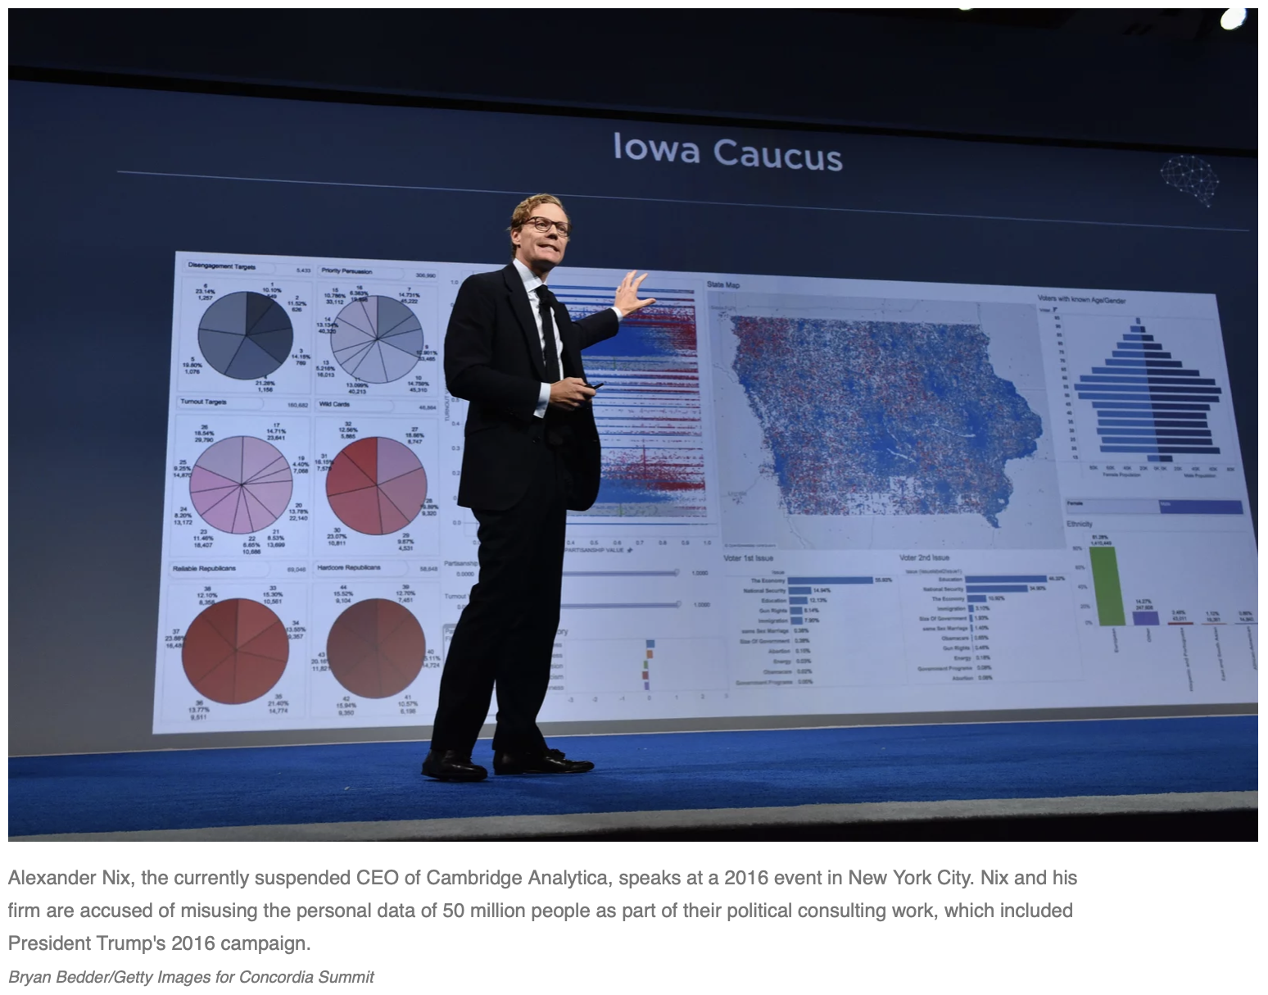
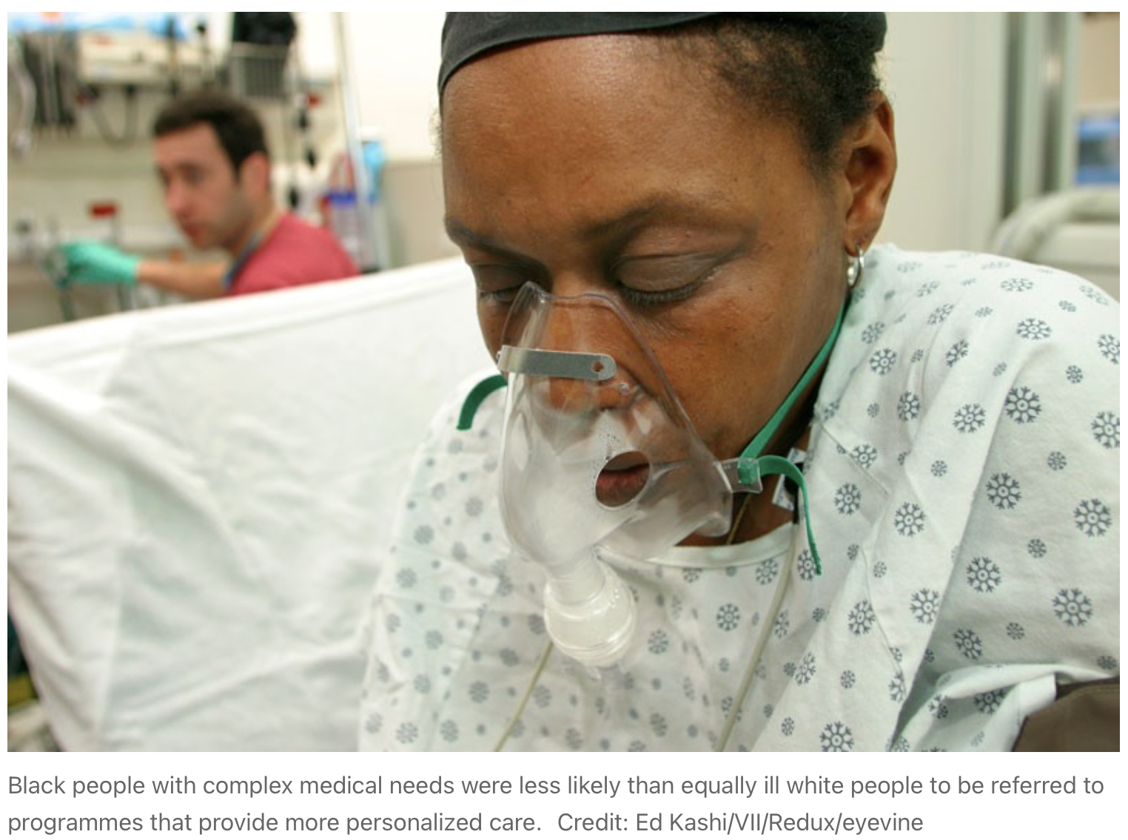
“Big Data” Unbounded — Ethical Issues
Some (relatively) recent controversies:
Cambridge Analytica controversy: psychological profiles of American voters
Racial bias in health algorithms: results in reduced access to care for Black people
Notes:
Gloss these - students can read later
I am going to share three unique examples of problems or issues with AI (Artificial intelligence) which uses Big Data.
First example is primarily about Privacy Concerns. Cambridge Analytica, a political consulting firm, came under scrutiny in the 2016 election for gaining access to tens of millions of Facebook user’s data & using it for political advertising. They used a FB linked survey to collect data on American voters, scraped their data from FB accounts, which they used to create psychological profiles and then sold it for political campaigns. They breached FB’s user privacy policy. Facebook's rules at the time allowed the app to suck up information about all those users and, even more importantly, information about their friends. That data included education, location, the groups and pages they liked, their relationship status, and where they worked. OR Read selected sections
The second example is of racial bias in algorithms which can introduce and reinforce societal discrimiation into a system. A study, published in Science journal, found that an algorithm widely used in US hospitals to allocate health care to patients has been systematically discriminating against black people. It concluded that the algorithm was less likely to refer black people than white people who were equally sick to programmes that aim to improve care for patients with complex medical needs. Bias occurs because the algorithm uses health costs as a proxy for health needs. Less money is spent on Black patients who have the same level of need, and the algorithm thus falsely concludes that Black patients are healthier than equally sick White patients. Black people needed to be sicker to receive the same treatment as white people. OR Read the Examining assumptions in the article

Slide 25
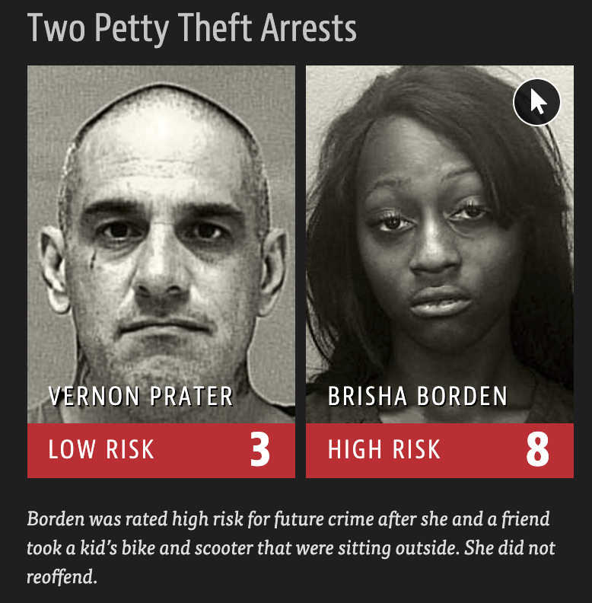
“Big Data” Unbounded — Ethical Issues
Use of facial recognition:
Clearview AI: sells facial recognition “services”
Case of Robert Williams: wrongfully arrested
Machine Bias: Software used to predict future criminals, biased against Black men
Stanford study creates AI that can predict sexual orientation based on a photo with up to 91% accuracy
Most algorithms have been found to contain gender and racial bias when tested on the accuracy of their face recognition
These issues were present from the onset of the implementation of these technologies, but they still got introduced
These biases are reproduced both in the programming of algorithms, and in collection of datasets from which algorithms are trained
Notes:
Example of facial recognition that threatens privacy rights and is often biased - It is one of the most powerful and controversial technological innovations of the 21st century. Driven by artificial intelligence, facial recognition allows officers to submit images of people’s faces, taken in the field or lifted from photos or video, and instantaneously compare them to photos in government databases — mugshots, jail booking records, driver’s licenses. But these systems are proliferating amid growing concern that facial recognition remains prone to errors — artificial-intelligence and privacy researchers have found that algorithms behind some systems incorrectly identify women and people with dark skin more frequently than white men — and allows the government to expand surveillance of the public without much oversight. OR Read from Matching Faces
Clearview AI is a company which offers a facial recognition AI solution, but came under scrutiny for selling it to non-law enforcement and private entities.
[Optional] Clearview AI runs a powerful neural network that processes photographs of faces and compares their precise measurement and symmetry with a massive database of pictures to suggest possible matches. It’s unclear just how accurate the technology is, but it’s widely used by police departments and other government agencies. Clearview AI has been heavily criticized for its use of personally identifiable information, its decision to violate people’s privacy by scraping photographs from the internet without their permission, and its choice of clientele. Or read from “The secretive company says it has created…...Do we want to live in a world where this technology exists?”....And critics say facial recognition is way too risky, enabling excessive surveillance and threatening our privacy rights. Another concern is that the technology, broadly, has also been shown to be less accurate on people of color, women, and other minority groups.
Robert Williams is a case of how things can go wrong. He is a black man who was wrongfully arrested because of facial recognition got it wrong and the police failed to do due diligence.
The ProPublica article on Machine Bias is another great article describing the shortcomings of facial recognition technology and its unfair treatment on the people of color.
A 2018 Stanford research which used deep neural networks to extract features from 35,326 facial images. These features were used to classifying sexual orientation. Given a single facial image, a classifier could correctly distinguish between gay and heterosexual men with upto 91% accuracy. Critics accuse authors of entering ethically gray area, potential use of their work for anti-LGBTQ purposes, violation of privacy etc.
I encourage you all to read these articles and explore the challenges that remain to be solved.
As you review these articles I want you all to to think:
Why the software used for policing is biased?
Do technology and big data-driven solutions eliminate human bias or amplify it?
What can be done to decrease bias and improve data-driven decision-making software?
[If Time allows]: Does anyone want to comment?
Explanations
All I will add is that Algorithms are not neutral! While they do not have minds of their own, people create these algorithms and judgments get encoded in the algorithmic process at all stages. Also, the computing processes and data itself may reflect the biases of people and society. These biases are reproduced both in the programing of algorithms, and in collection of datasets from which algorithms are trained.
[Optional] Because the concern and criticism against facial recognition in policing is rising, IBM CEO in 2020 said “We believe now is the time to begin a national dialogue on whether and how facial recognition technology should be employed by domestic law enforcement agencies,”
If time permits ASK: Have any of you every experienced a bias while using a technology? Feel free to share.
[Optional] My personal experience: I faced issues with speech recognition when Siri and Alexa were new to the market. They won’t understand my accent. Now their developers have expanded the accents that voice assistants can comprehend, and their is an option to train your assistant to recognize your accent by giving it more voice data. However, the challenges of many people still continues.

Slide 26
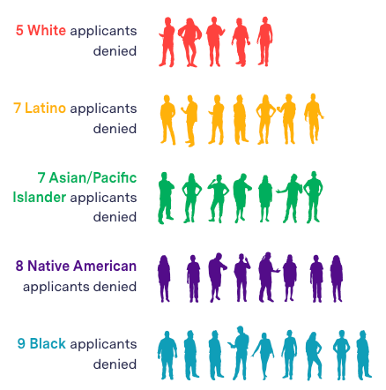
Algorithmic Injustice
Mortgage approval algorithms can gather and use data in ways that express a racial bias.
On Fannie & Freddie, who buy about half of all mortgages in America: “This algorithm was developed from data from the 1990s and is more than 15 years old. It’s widely considered detrimental to people of color because it rewards traditional credit, to which White Americans have more access.”
Notes:
Fannie & Freddie, who “buy about half of all mortgages in America,” use “Classic FICO,” a credit scoring algorithm that determines “whether an applicant meets the minimum threshold necessary to even be considered for a conventional mortgage, currently a score of 620” (Martinez and Kirchner). This algorithm was made from data collected in the 90’s, and “It’s widely considered detrimental to people of color because it rewards traditional credit, to which White Americans have more access” (Martinez and Kirchner). Though newer and potentially fairer scoring algorithms exist, and though Fannie & Freddie have been pressured to replace theirs, their regulator, the Federal Housing Finance Agency, has “expressed concern about the ‘cost and operational implications” if they would have to continually test new credit scoring models’ “ (Martinez and Kirchner). This is just one example of how algorithms can, through certain (mis)uses of data incentivized by monetary interests, reinforce hegemonic material conditions and negatively affect our real lives in ways that are often mystified or otherwise made invisible to us.
Source of image: The Markup, HMDA Data, illustrations from ProPublica. “We applied the odds ratios from our regression to White applicants’ actual denial rates to calculate the number of denials for each racial and ethnic group above. These numbers are not the actual denials or actual number of applications in each location, but rather have been standardized for comparison. We rounded to the nearest person.”
Source: Martinez, Emmanuel and Lauren Kirchner. “The Secret Bias Hidden in Mortgage-Approval Algorithms,” The Markup, Aug. 25, 2021. Available at https://themarkup.org/denied/2021/08/25/the-secret-bias-hidden-in-mortgage-approval-algorithms

Slide 27
More examples of introducing bias
“Falsehoods programmers believe about names” - Patrick McKenzie
How does a program recognize a “name”?
Criteria that programmers insert in order to enable a program to recognize a “name” are informed by programmers’ assumptions and biases
Some examples of the assumptions from the text:
People’s names fit within a certain defined amount of space.
People’s names do not change.
People’s names are written in ASCII.
People’s names are written in any single character set.
People’s names are case sensitive.
People’s names are case insensitive.
Can you think of any examples?
You can find some examples here as well
Notes:
https://www.kalzumeus.com/2010/06/17/falsehoods-programmers-believe-about-names/
https://shinesolutions.com/2018/01/08/falsehoods-programmers-believe-about-names-with-examples/

Slide 28
“Big Data” can also inform solutions to complex problems:
Prof. Lazar and NetSI researchers at Northeastern have been working on COVID-19 research using big data
Scientists have also created algorithms that can predict the likelihood of cancer (Breast cancer, Prostate cancer)
An example from the social sciences: Allegheny County PA “family screening tool” to support human screeners in the Department of Children, Youth, and Families
Notes:
Does the problem lie inherently only in the algorithm or also its application? What do you think?
Not all algorithms or AI is bad! Algorithms, Machine Learning and Data Analytics are increasingly being used to study, analyze and solve some of the world’s most complex problems. From climate change to COVID!
Check out the work the Network Science Institute at Northeastern has been doing on COVID-19. They are using big data to study and predict outbreaks, analyzing the factors that are likely to affect the spread like travel, geography, demographics etc.
AI is helping save human lives, for instance by predicting the likelihood of cancer.
When used along with human expertise and experience, and implemented in a way that fosters transparency with the community, AI can process a variety of materials much more quickly than humans and help professionals work more efficiently

Slide 29
Algorithms & Big Data: What gets counted counts
“What is counted—like being a man or a woman—often becomes the basis for policymaking and resource allocation. By contrast, what is not counted—like being nonbinary—becomes invisible...”
When we look at the data used to train an algorithm, we must ask what kinds of data are being counted, and what kinds of data are being overlooked, ignored, excluded?
What are the consequences of counting and not counting different kinds of data on various populations, especially marginalized groups?
SOURCE: “What Gets Counted Counts” Principle #4 of Data Feminism (mitpress, 2020)
Notes:
From: 4. “What Gets Counted Counts” Principle #4 of Data Feminism is to Rethink Binaries and Hierarchies. Data feminism requires us to challenge the gender binary, along with other systems of counting and classification that perpetuate oppression. by Catherine D'Ignazio and Lauren Klein (2020) (https://data-feminism.mitpress.mit.edu/pub/h1w0nbqp/release/3)
“What gets counted counts,” feminist geographer Joni Seager has asserted, and Munir is one person who understands that.undefined What is counted—like being a man or a woman—often becomes the basis for policymaking and resource allocation. By contrast, what is not counted—like being nonbinary—becomes invisible (although there are also good reasons for being invisible in some contexts, and we’ll come back to those shortly). Seager’s research focus is gender, the environment, and policy (see figure 4.1), and she points out that there is more global data on gender being collected than ever before. And yet, these data collection efforts often still leave many people out, including nonbinary people, lesbians, and older women. Even among those who are counted, they tend to be asked very narrow questions about their lives. “Women in poor countries seem to be asked about 6 times a day what kind of contraception they use,” Seager quipped in a lecture at the Boston Public Library. “But they are not asked about whether they have access to abortion. They are not asked about what sports they like to play.”

Slide 30
Questions to consider/Discussion:
What are some benefits and what are some risks coming with the increased focus on ‘big data’ in research and policy?
Are technology- and big data-driven solutions more likely to eliminate human bias or amplify it?
Do problems lie inherently only in the algorithm or also its application?
In any case study, where can we find data-driven analyses, possible solutions, or policy arguments?
How can we critically analyze these to determine whether the data is being used ethically?
Notes:
More Qs:
Do you see any commonalities among the risks? How would you address them?
In any given research project, which concerns take precedent when it comes to data collection and ethical use of collected data?
“Big Data” is a vague term that can refer to many different phenomena at once. What are some other terms you would use in order to think about these issues more precisely?

Slide 31
Want to learn more about accountability and best practices when creating algorithms?
Visit https://www.fatml.org/, or Fairness, Accountability, and Transparency in Machine Learning
Watch this PBS video, if you want to learn about the five common types of algorithmic biases that we should pay attention to and ways to reduce them.
Notes:
I will end this exercise by saying - In this modern era, machine learning and artificial intelligence are becoming ubiquitous, and decisions are increasingly automated and being processed by algorithms. Hence, it is important to remember that algorithms can be biased and we should remain critical of the recommendations from artificial intelligence. Privacy law experts believe that the codes and data for artificial intelligence and algorithms that impact people's life should be made more fair and transparent.
Read the Slide

Slide 32
Data Justice

Slide 33
Definitions of Data Justice
Data justice is an approach that redresses ways of collecting and disseminating data that have invisibilized and harmed historically marginalized communities. For decades, if not centuries, data has been weaponized against BIPOC communities, in particular, to reinforce oppressive systems that result in divestment and often inappropriate and harmful policies.
From the Coalition of Communities of Color explanation of “Research Justice”

Slide 34
Definitions of Data Justice
Data justice aims to capture forms of knowledge and lived experiences that are community-centered and community-driven to counter the systemic erasure and harm perpetrated on BIPOC communities via oppressive data practices. The fundamental premises of data justice are that data should: (1) make visible community-driven needs, challenges, and strengths, (2) be representative of community; and (3) treat data in ways that promote community self-determination.
From the Coalition of Communities of Color explanation of “Research Justice”

Slide 35
Examining Data Justice Processes
STRUCTURAL DATA JUSTICE
DISTRIBUTIVE DATA JUSTICE
PROCEDURAL DATA JUSTICE
INSTRUMENTAL DATA JUSTICE

Slide 36
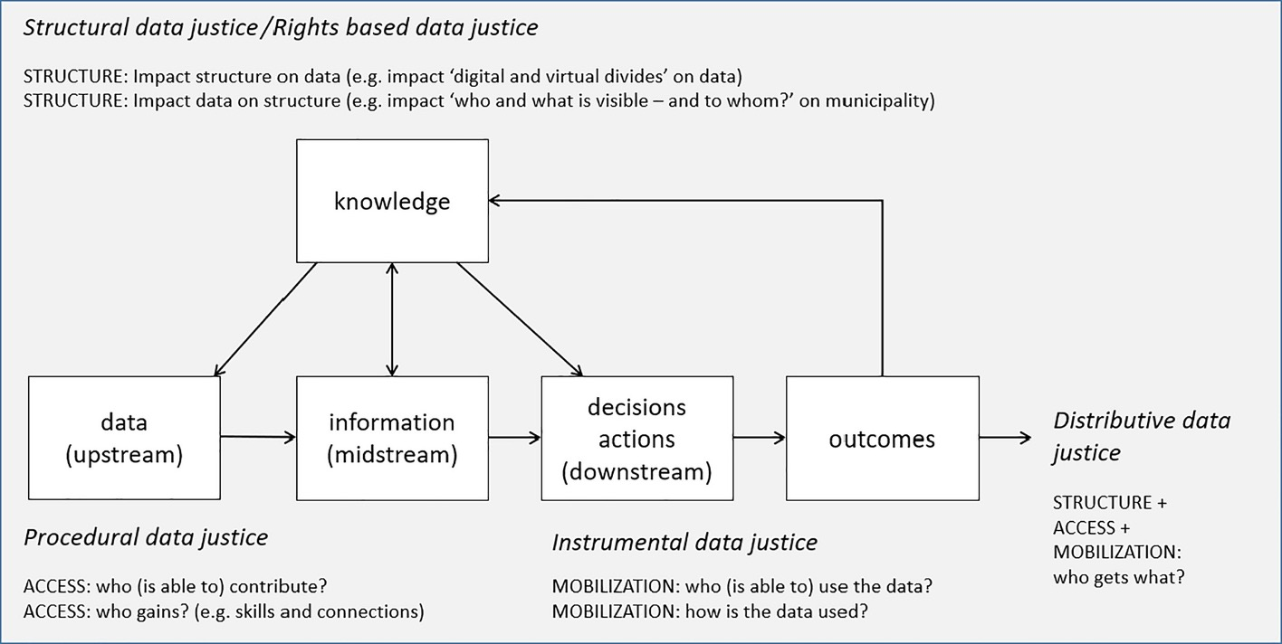
Structural Data Justice
Notes:
Student Inquiry Activity:
What is going on in this graphic?
How do structural, procedural, instrumental, and distributive data justice relate to one another?
At which points in the process of data collection, data analysis, and application of findings can we aim to be more judicious and equitable?
https://onlinelibrary.wiley.com/doi/full/10.1111/1468-5973.12335

Slide 37
Structural Data Justice
Notes:
Structural Data Justice refers to the ways in which a data project’s social context and execution affects all other dimensions of data justice. In terms of e-resilience, it looks at how resources and social connections (social capital) are structured and (re)produced through information communication technologies (ICTs)
Shunan to add more to describe what this step in the process looks/sounds like
Structural data justice is situated within a concern for the relationship between data and structural inequality and propose a means of systematically analysing data justice in development contexts. It focuses on the degree to which the interests and power in wider society support fair outcomes in other forms of data justice.
Can you think of an example of Structural data justice/ Rights-based data justice (or injustice)?
https://onlinelibrary.wiley.com/doi/full/10.1111/1468-5973.12335
Structural data justice

Slide 38
Structural Data Justice
Notes:
Procedural Data Justice refers to fairness in how data are handled, whether the process implemented based on its initiatives
Shunan to add more to describe what this step in the process looks/sounds like
Can you think of an example of Procedural data justice (or injustice)?
https://onlinelibrary.wiley.com/doi/full/10.1111/1468-5973.12335

Slide 39
Structural Data Justice
Notes:
Instrumental data justice looks at how fair the outcomes are of the decisions and actions taken based on data (Heeks, 2017). It refers to fairness in the results of data being used.
Shunan to add more to describe what this step in the process looks/sounds like
Can you think of an example of Instrumental data justice (or injustice)?
https://onlinelibrary.wiley.com/doi/full/10.1111/1468-5973.12335

Slide 40
Structural Data Justice
Notes:
Structure + Access + Mobilization = OUTCOME (who gets what?)
It is an overarching dimension relating to the (in)equality of data-related outcomes that can be applied to each of the other dimensions of data justice.
Shunan to add more to describe what this step in the process looks/sounds like
Can you think of an example of Distributive data justice (or injustice)?
https://onlinelibrary.wiley.com/doi/full/10.1111/1468-5973.12335

Slide 41
Some Examples
Which type of data justice could each example represent?
● Bureaucratic systems designed to assure that people are not misusing state welfare funds and other publicly funded support are part of the apparatus of governmentality
● Data-driven law enforcement focuses unequally on poor neighborhoods which experience certain types of criminality
● Undocumented migrants are tracked and acted upon by digital systems in more invasive ways than higher income travelers.
Tech companies (eg: FB)’ misuse of privacy datasets
Notes:
Give students 2-3 minutes in small groups to discuss the examples and to determine whether they make the most sense as examples of
Structural data justice
Procedural data justice
Instrumental data justice
Distributive data justice
Bureaucratic systems: distributive
Data-drive law: structural
Undocumented: procedural
Tech companies: instrumental
Have students share out with the whole group and discuss ways of categorizing these examples (5-8 minutes)

Slide 42
Data and Precarity
“…problems of exclusion cannot be solved simply by including Black women within an already established analytical structure. Because the in- tersectional experience is greater than the sum of racism and sex- ism, any analysis that does not take intersectionality into account cannot sufficiently address the particular manner in which Black women are subordinated.” - Crenshaw, “Demarginalizing the Intersection of Race and Sex” (1989)
While specific to Black women, Crenshaw’s theory also stands to explain the specific challenges that people experience across multiple axes of identity i.e., when they are Black or non-white, and non-male, and/or otherwise a member of a group facing identity-based discrimination.
The DITI borrows from legal scholar and theorist Kimberlé Williams Crenshaw’s theory of intersectionality (1989) to understand the multiplying impact of data discrimination and algorithmic bias on oppressed persons, and to help consider possibilities for data justice.
Notes:
SPEAKER NOTES:
In her article “” (1989), Crenshaw uses several metaphors to describe intersectionality, and solidifies her description with a court case showcasing the specific, targeted oppression Black women received at the company under which they were employed.
DeGraffenreid v. General Motors was a 1976 case in which five black women sued General Motors for a seniority policy that they argued targeted black women exclusively–laying all Black women off during the recession in the 1970s, while keeping all other raced and gendered persons employed. The discrimination these women experienced was not with regard to one facet of their identity, but multiple–both a gendered and racist form of discrimination. Crenshaw’s theory helps us understand and account for how some persons (usually non-white, non-male, and non-Christian) face double-, triple-, etc jeopardy under systems of control: legal, data, and otherwise.

Slide 43
Considering Intersectionality in Data Justice
A range of interacting and overlapping identity characteristics (e.g., race, ethnicity, religion, gender, location, nationality, socio-economic status, etc.) determine how individuals are made into administrative (institutionally) and legal (as non/citizen) subjects through their data and, consequently, how data can be used to act upon and against them by policymakers, commercial firms, and other entities.
Depending on the various identities a person inhabits–especially for with regard to race, gender, and sexuality–the likelihood of and frequency by which someone identified as a target of surveillance multiplies.

Slide 44
A Data Justice Example from the Boston Area Research Initiative (BARI)

Slide 45

BARI’s Statement on Data Justice:
BARI’s Data Justice Statement
Notes:
The next few slides will examine this statement more closely; refer students to the link if they are interested in exploring the document in full

Slide 46
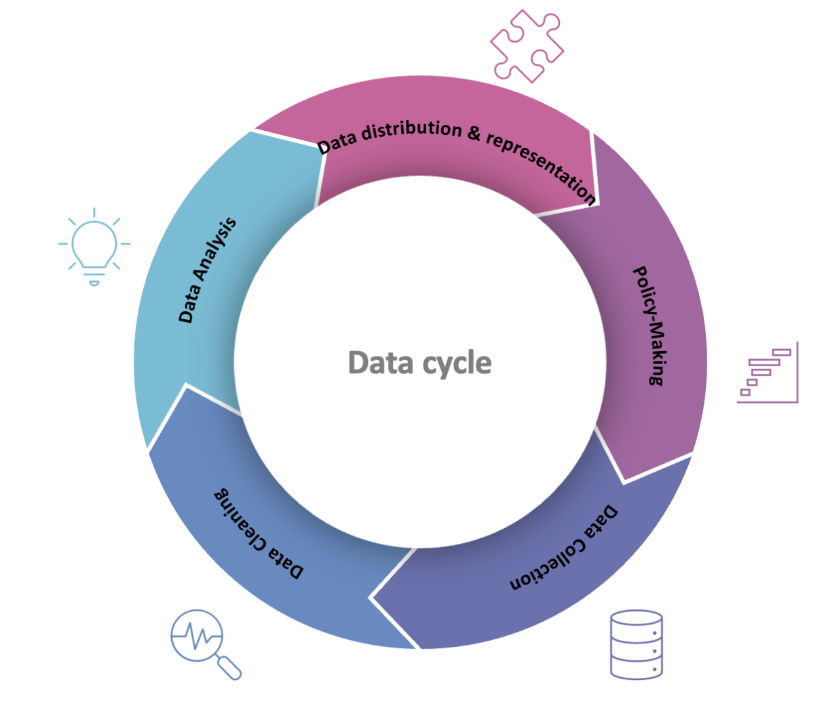
The Data Cycle:
Notes:
This graph illustrates the data life cycle:
Data collection – data cleaning – data analysis – data distribution & representation – policy-making

Slide 47
BARI’s Statement on Data Justice
Examine the following excerpts from
Data is for all, thus the data accessibility and employment should be inclusive, representative and serve for every voice.
data training targeted contents: we provide training on how to engage with data (including data analysis and data visualization) for all potential users through an intersectional approach
Transparency in acknowledging the strengths and weaknesses of naturally occurring data (seeing the holes) and communicating effectively about methods and limitations.
Discussion question:
Imagine, you just scraped Airbnb dataset from websites:
How will you clean the datasets?
How will you communicate the limitation of the research?
Notes:
Shunan to pull relevant excerpts from the statement and write discussion questions on this slide

Slide 48
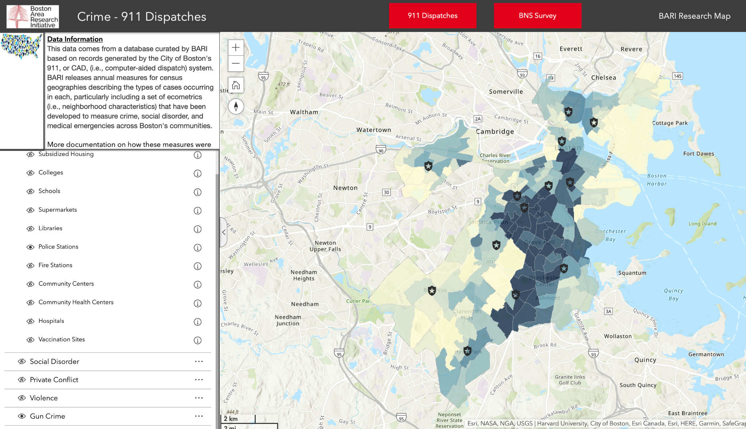
An Example from BARI: Boston 911 Data
Use this link to explore the interactive map
Notes:
Use this link to show and explore the interactive map: https://experience.arcgis.com/experience/ce3975f9368841f791d1fc8891e6171b/page/page_2/
3-5 minutes to pop out to the visualization, if desired (with BARI representative)

Slide 49
Class Activity: Northeastern’s COVID-19 Research - Data Collection and Consent
Notes:
Cara
Big data relies on collecting and categorizing information, similar to how academic research works. As we asked questions about big data, so should we ask questions about our own research, particularly when it comes to questions about ethics, representation, and implicit biases and ideologies located in our collection and analysis process.

Slide 50
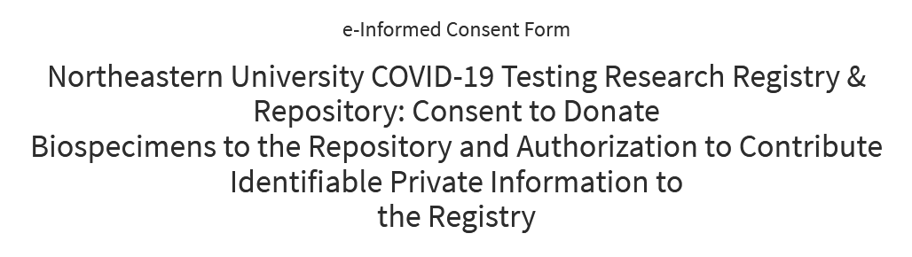
Northeastern’s COVID-19 Research:
Consent Form Analysis
Northeastern runs a testing program, which it tries to connect with research initiatives
The research project is called “Northeastern University COVID-19 Testing Research Registry & Repository,” and the lead researchers are Jared Auclair, PhD. and Spencer Pruitt, PhD. from the Department of Biotechnology & Bioinformatic, College of Science; ITS. The research is sponsored by Northeastern University.
In order to collect data for research, the researchers have provided a consent form—let’s examine some language from the form, and then discuss!

Slide 51
Some selections from the consent form
The project for which the consent is given: “Northeastern University COVID-19 Testing - Research Registry & Repository”
"We do not know in advance what specific research projects will request use of your information or biospecimens. Future research studies may involve testing, diagnosis, prediction, prevention, treatments; genetic and genomic studies, including whole genome sequencing of SARS-CoV2; analyses for public health officials and social, scientific and medical research."
"Your materials and data may be used by Northeastern faculty and investigators and their research collaborators; Northeastern University research collaborators may include investigators from other universities, research institutions, industry, non-profit foundations and public health agencies."
Your consent to participate in the registry and repository allows Northeastern to share your data and samples with researchers anywhere, including those in other countries or working for other academic, medical or research institutions, companies, non-profit foundations and public health agencies."
"Your consent to participate in the registry and repository allows researchers to use your samples and data to study any research question"

Slide 52
Northeastern and data: discussion
How specific are these points on the future usage of data?
What are the limitations on what they can do with this data, based on these points?
How clear is it how this data will be used? How clear do you think it should be, and why?
How clear is it with whom this data will be shared? What could be the purposes of sharing it with companies?
What other Northeastern’s data-related practices would you like to critique, and how?

Slide 53
Class Activity:
Algorithms and Bias
Notes:
Lets now get into the activity mode!

Slide 54
Activity: Adopt or Not?
You all work for an animal adoption agency. You have access to four previous adoption applications and their outcomes. You will use these to decide if the new applicant can adopt a dog or not.
You will be assigned into small groups for this exercise. Have a group discussion and try to come up with a unified decision.
Do you think this new applicant should be allowed to adopt a dog? Why or why not?
Notes:
Provide the “Adopt a Dog” handout.
Give them 5-10 minutes to read through the handout and discuss (depending on how much time is left)

Slide 55
Class Discussion: Adopt or Not?
Would you ACCEPT or REJECT their application? Why?
What questions from the application did you weigh more? Why?
What might be some implicit biases in this application form, the process, and in your choices?
Notes:
[10 minute class discussion]
When you are an adoption agency, you want to make sure you’re finding applicants who have safe homes and will not potentially bring dogs back to the shelter.
Questions to discuss:
Neighborhood. Emphasis on dog parks, vets, etc.. Usually implies wealthier socioeconomic class
Renting vs owning: people who rent are less likely to be able to adopt because of worries about landlords. Also, renting implies less stability, which may mean at one point the owner might have to choose to re-shelter the pup
House vs Apartment: even if you own your apartment, some apartments may not allow animals. Plus, with homes, there’s typically more space for dogs to run around
Work hours: how much time will people have for their dogs?
Fenced in backyard: again, what is important is investment in space and time and, usually implies money in some way
Insurance: buying insurance may imply a) you have money to spend and b) you’re willing to spend it on the dog
Allergies: people who are allergic may be less likely to keep the dog
Implicit biases – SOCIOECONOMIC CLASS:
Neighborhoods. Want “good” neighborhoods, middle class, wealthy, etc.
Want people who own property and are stable, again tying in class and such
Hours: want someone who can afford to stay home or can afford dog walkers

Slide 56
Adopt or Not? Algorithm
Algorithms can “read” through data such as these applications, and help us make decisions. Here are some questions to think about when assessing algorithms:
Where might you see these algorithms being used to make decisions? Why are they being used? What are they replacing or adding onto?
What biases may be ingrained in the data collected for the algorithms? What biases may be ingrained in the actual process of using the algorithms?
In what ways might the algorithms prevent or reinscribe human biases?
Notes:
This is an example of how algorithms and machine learning works. This is an example of supervised machine learning. You have a set of instructions, or in this case questions, and different questions might have different weights. The algorithm calculates the final results–yes or no–based on how the questions were filled out and how much the question weighs.
So, for example, if you have an adoption applicant who has multiple children and you believe that the more children someone has, the more chaotic the household may be for a dog. You might say to your algorithm “if this number is high, weigh this application on the “not” scale.” And then continue to do this with each question.
Algorithms are used to held assess people, like teachers or defendants on trial. They are also being integrated into job applications and opportunities. For example, how many of you heard about Amazon’s resume machine learning algorithm controversy last year?

Slide 57
Class Activity:
Search Engine Bias Example and Discussion
Notes:
[Claire Take Over]

Slide 58
“Greatest Authors of All Time”
Open Google’s search engine and type in “Greatest authors of all time.”
What are some of the results? What do you notice about these results?
Where do you think these results came from?
How many authors on this list have you read? Do you agree with the list?
What do these results suggest to you in terms of defining “greatest” and “authors”?
Notes:
If using zoom, have students list results in the chat, answer questions in the chat, then prompt students to say more verbally

Slide 59
“Greatest _______ Authors of All Time”
Now try these results:
Greatest women authors
Greatest Black women authors
Greatest Black authors
Greatest white authors
“Black” leads to substantial results, while “white” does not. Why do you think this might be?
Notes:
WHITENESS AS UNIVERSAL, NOT NECESSARILY NEEDING TO BE MARKED. BUT IT’S EVERYWHERE. IT DEFINES OUR CULTURE

Slide 60
Technology is Not Neutral
Information systems like Google as well as data collection, data analysis, and algorithms are not neutral.
They can reinforce and make explicit systemic, political, and cultural biases.
They are affected by input data, the way that data is presented, how the data is interpreted by machines, and more.
This means we also have the ability to challenge these biases, norms, and forms of discrimination.
Notes:
Do white men really make better authors than white women, Black women, and Black men? According to the literary canon and Google, yes, they do! But should we just accept this?

Slide 61
Biases in Scholarship
and
Archival Silences
Notes:
So how do we challenge biases, assumptions, and norms within our own academic research and work?
Academia isn’t immune to the same issues of biases being perpetuated - but what does it look like, and how can we work to disrupt those harmful cycles?

Slide 62
Bias in Scholarship
Questions to consider:
Whose voices and expertise are valued and heard?
What kinds of data are prioritized in scholarship, and how/how often are they used?
Whose voices and experiences and bodies can we easily find in the historical record, and whose are missing?
What other sources of information might help fill in gaps in the ‘official’ records found in archives and academic discourse?
Notes:
Think of intersectionality - whose voices are easy to find, and what are they talking about?
Whose voices are missing?
Whose voices speak loudly on one aspect of their lives, but remain silent in other aspects?

Slide 63
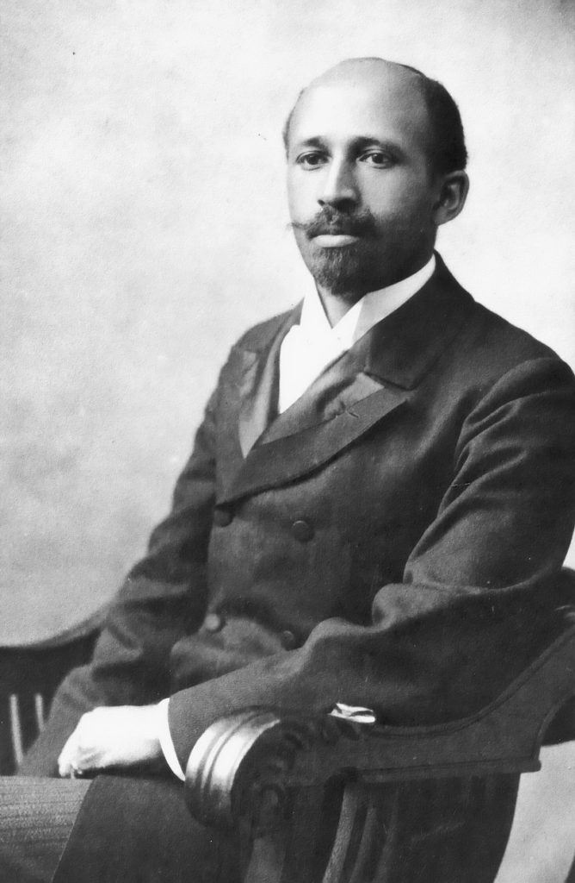
Bias in Scholarship
W. E. B. DuBois, b. 1868 d. 1963 (NAACP founder, scholar, sociologist, writer, activist)
Published “Black Reconstruction in America: An Essay Toward a History of the Part Which Black Folk Played in the Attempt to Reconstruct Democracy in America, 1860–1880” in 1935
Emphasized the role and agency of African Americans during the Civil War and Reconstruction and framed it as a period that held promise for a worker-ruled democracy to replace a slavery-based plantation economy.
Notes:
One example from history is that of the reception of W.E.B. DuBois’s history of the United States from 1860 to 1880.
DuBois was a scholar and an activist, and brought both personal lived experience and evidence-based scholarship to his analysis.

Slide 64
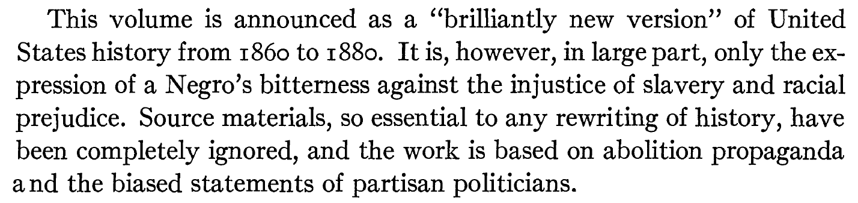
A review of DuBois’ scholarship by a prominent academic at the time:
Notes:
DuBois’s work was criticized and demeaned as partisan and illegitimate.
Think about the peer-review process scholars around the world use today to collectively determine what scholarship is worthy of publication (and therefore, valuable) - where could we see biases creeping in? Could voices like DuBois’s be marginalized or demeaned in the system we use today?
I'd do some under-lining here on what the writer is dismissing as "appropriate data." And then in the speaker notes backtrack to the concept earlier on that "what gets counted (as data) counts"
***If time permits, pause for discussion***

Slide 65
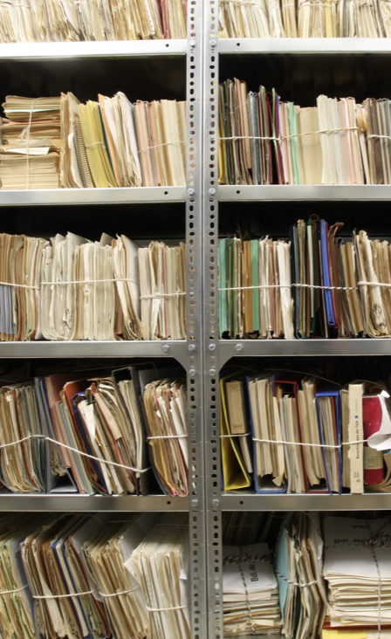
Archives and the “Historical Record”
Archives
What comprises the historical record?
What information gets saved, and what doesn’t?
Who makes the decisions about what can and cannot be included in “official” records?
Notes:
And what happens when we go further back, or think about how scholars in the future will learn about our lives and experiences today?
What information gets saved? What becomes part of humanity’s ‘permanent record’ in public and private archives?
Think of archives as holding the data sets of history
https://www.archives.gov

Slide 66
Archives and Archival Silences
Archival silences
Whose voices, bodies, and experiences are missing from the historical record?
How can we mitigate archival silences in our work?
How can we think of our work as a response to or a disruption of these silences?
Notes:
Think about how a researcher 50 years from now would learn about your life today - what you do all day, who your friends are, where you like to go and what you like to buy, etc. Where would they need to look to find the information they would need to get a complete (or even somewhat complete) picture of you and your life?
Where would such a researcher need to go to learn about someone from a marginalized population (think, someone experiencing homelessness, someone who is trying to flee a humanitarian crisis in their country, someone who is incarcerated, etc.)?
There are a number of digital archives housed by universities (including Northeastern) that exist to preserve and gather the records of marginalized communities or materials that are connected to specific events - the “Our Marathon” project is a digital archive of collections from the Boston Marathon Bombing in 2013, and the “Journal of the Plague Year” is an online crowdsourced (but curated and organized by a team of academics and graduate students) archive that focuses on the lived experiences of people during the first year of the COVID-19 pandemic
https://marathon.library.northeastern.edu
https://covid-19archive.org/s/archive/page/welcome
https://www.digitaltransgenderarchive.net

Slide 67
Data Presentation: Considerations
Notes:
Working with data, “Big” or otherwise, requires precision and intentionality in processes of data identification, data collection, data analysis, and presentation of results.
When we think about different methods that can be used to present data and conclusions based on data, we must be aware of the potential for the presentation methods to inform clearly and effectively, OR to misinform or misrepresent data and findings.

Slide 68
Misrepresentation of Data
From D.B. Resnik, in International Encyclopedia of the Social & Behavioral Sciences, 2001:
“The concept of ‘misrepresentation,’ unlike ‘fabrication’ and ‘falsification,’ is neither clear nor uncontroversial. Most scientists will agree that fabrication is making up data and falsification is changing data. But what does it mean to misrepresent data? As a minimal answer to this question, one can define ‘misrepresentation of data’ as ‘communicating honestly reported data in a deceptive manner.”
This online book from The Data School covers some common ways data could be misrepresented at multiple points in the process of gathering, analyzing, and presenting findings on data-based research.
Notes:
https://www.sciencedirect.com/topics/computer-science/misrepresentation
D.B. Resnik, in International Encyclopedia of the Social & Behavioral Sciences, 2001
5.3 Misrepresentation of Data
The concept of ‘misrepresentation,’ unlike ‘fabrication’ and ‘falsification,’ is neither clear nor uncontroversial. Most scientists will agree that fabrication is making up data and falsification is changing data. But what does it mean to misrepresent data? As a minimal answer to this question, one can define ‘misrepresentation of data’ as ‘communicating honestly reported data in a deceptive manner.’ But what is deceptive communication? The use of statistics presents researchers with numerous opportunities to misrepresent data. For example, one might use a statistical technique, such as multiple regression or the analysis of variance, to make one's results appear more significant or convincing than they really are. Or one might eliminate (or trim) outliers when ‘cleaning up’ raw data. Other ways of misrepresenting data include drawing unwarranted inference from data, creating deceptive graphs of figures, and using suggestive language for rhetorical effect.
However, since researchers often disagree about the proper use of statistical techniques and other means of representing data, the line between misrepresentation of data and ‘disagreement about research methods’ is often blurry. Since ‘misrepresentation’ is difficult to define, many organizations have refused to characterize misrepresenting data as a form of scientific misconduct. On the other hand, it is important to call attention to the problem of misrepresenting data, if one is concerned about promoting objectivity in research, since many of science's errors and biases result from the misrepresentation of data.

Slide 69
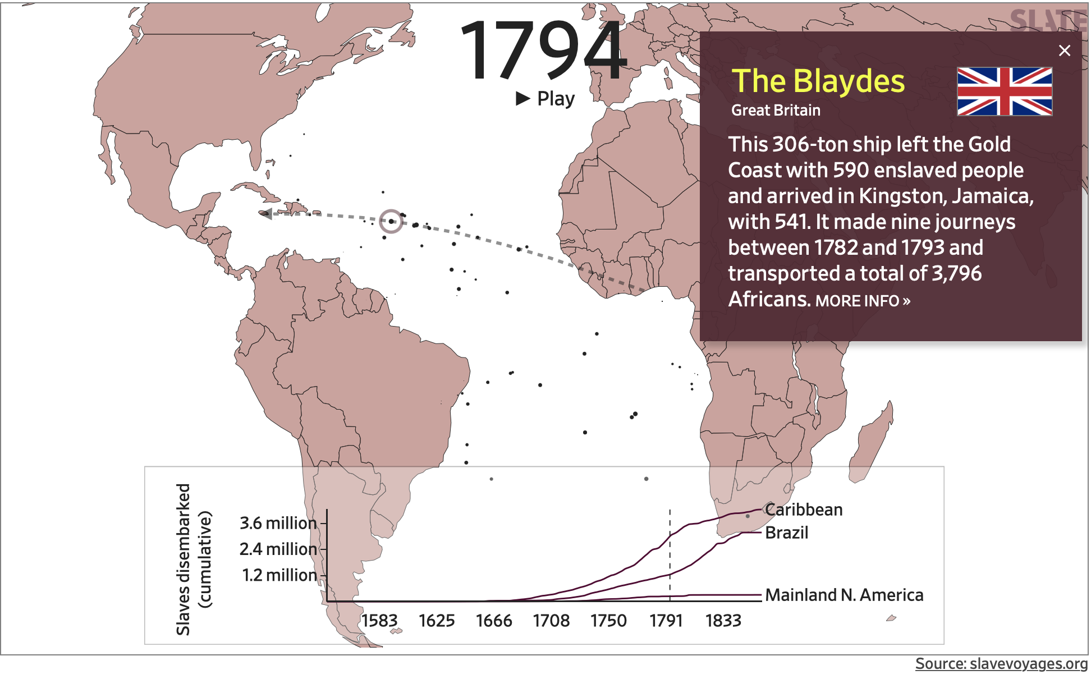
Even when data isn’t being willfully misrepresented, the way it’s presented can still end up being reductive…
This is a screenshot from a digital history project from Slate that visualizes information from the Trans-Atlantic Slave-Trade Database as an animated map. In the map, each dot represents individual slave ships, and the size of the dot corresponds to the number of enslaved passengers aboard. You can learn more about each ship’s history by clicking on its respective dot.
Notes:
Explain what i mean by reductive

Slide 70
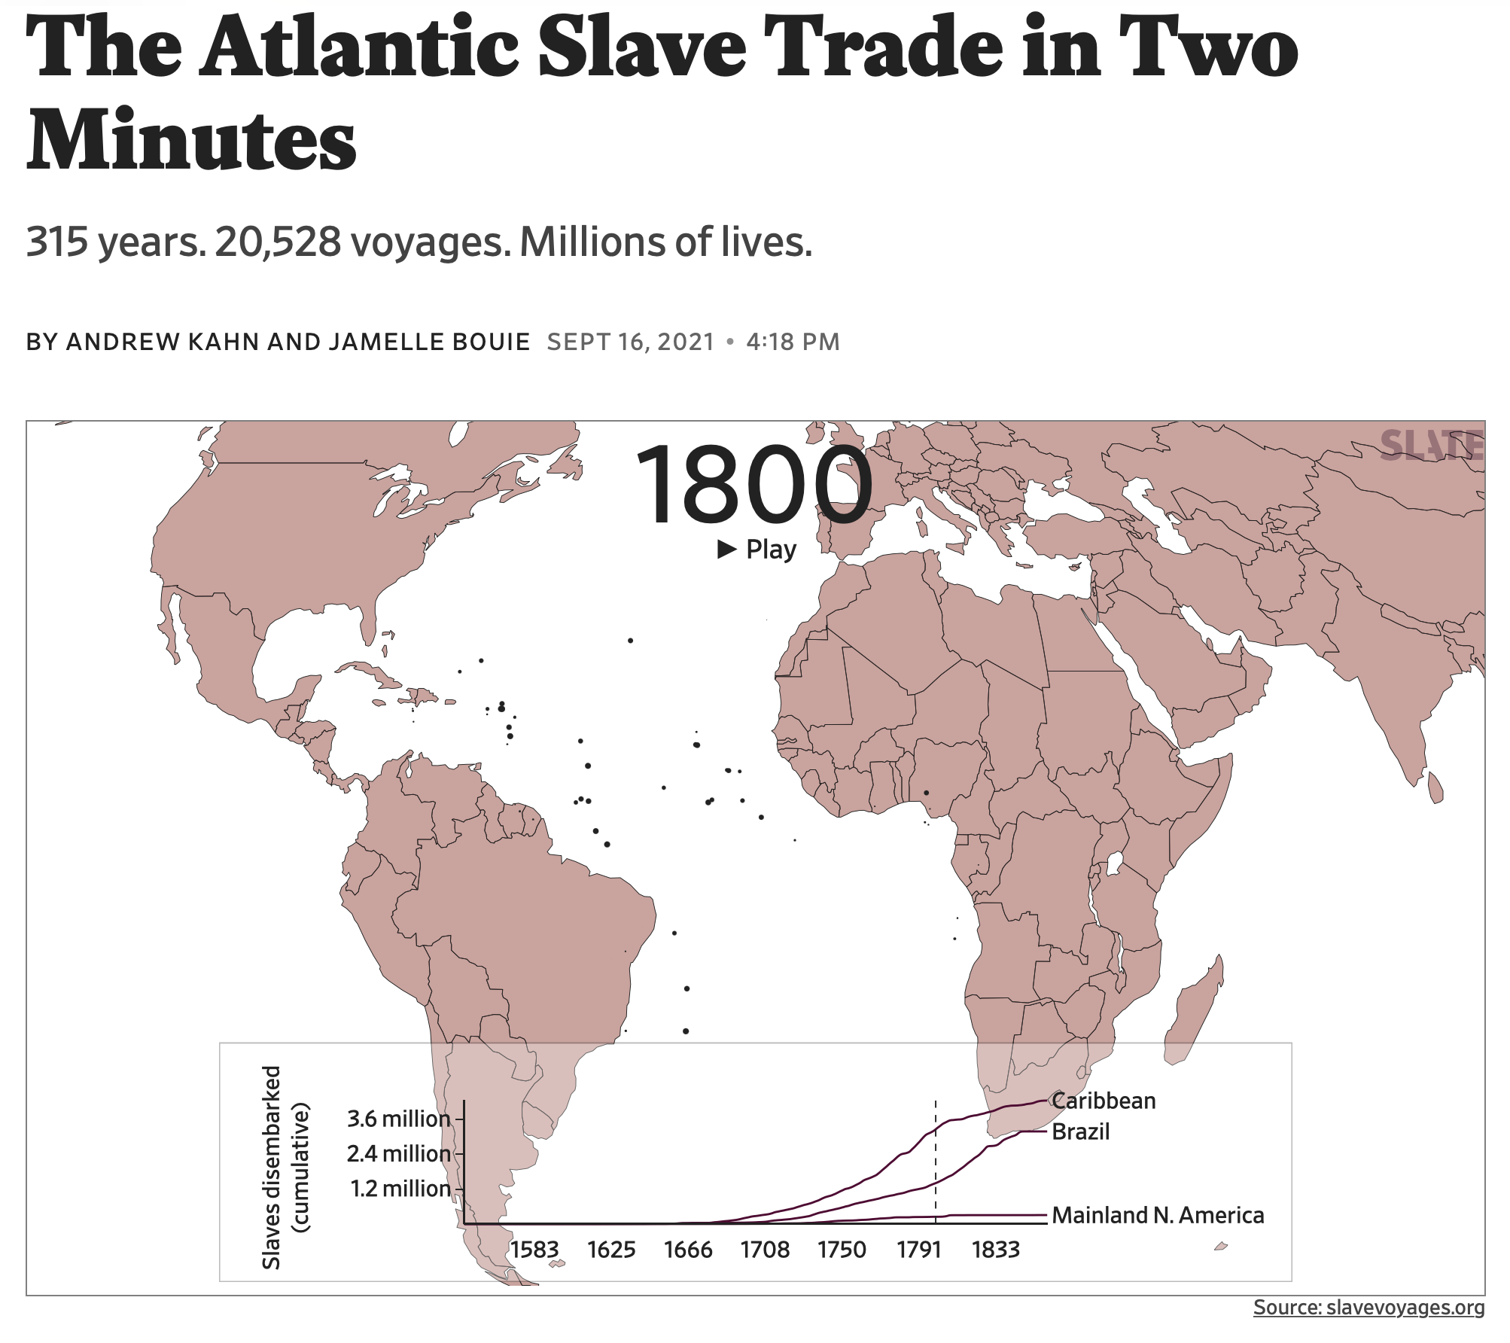
In this case, the map is presenting humans as objects rather than people.
Reductive data can end up doing real harm.
What happens when human lives become reduced to data points?
What is lost and what is gained in visual representations of data like this?
How can we represent data both accurately, completely, and with care?
Notes:
The Atlantic Slave Trade in Two Minutes
Reductive data can end up doing a lot of harm.

Slide 71
Limitations of Some Data Presentation
Methods: Maps
Viewers may have limited knowledge about the spaces depicted
Mapping technologies may not accurately/completely show all relevant variables
Navigability and clarity are concerns. Consider: how usable is the map?
Maps may not have been normalized (normalizing refers to adjusting data that may have been collected at different scales into a common scale), so comparisons might be inaccurate or misleading
Like any other type of rhetoric, maps can be used to tell—or obfuscate—specific stories

Slide 72
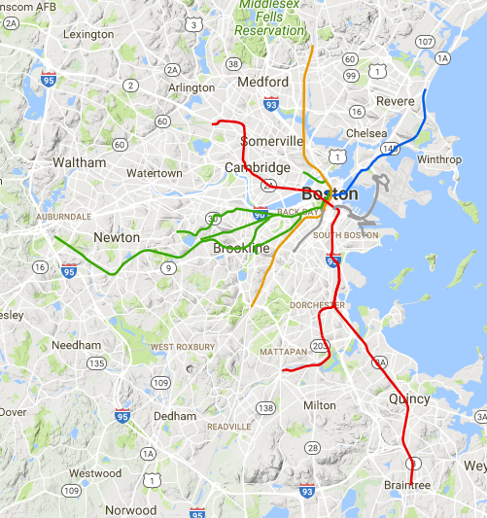
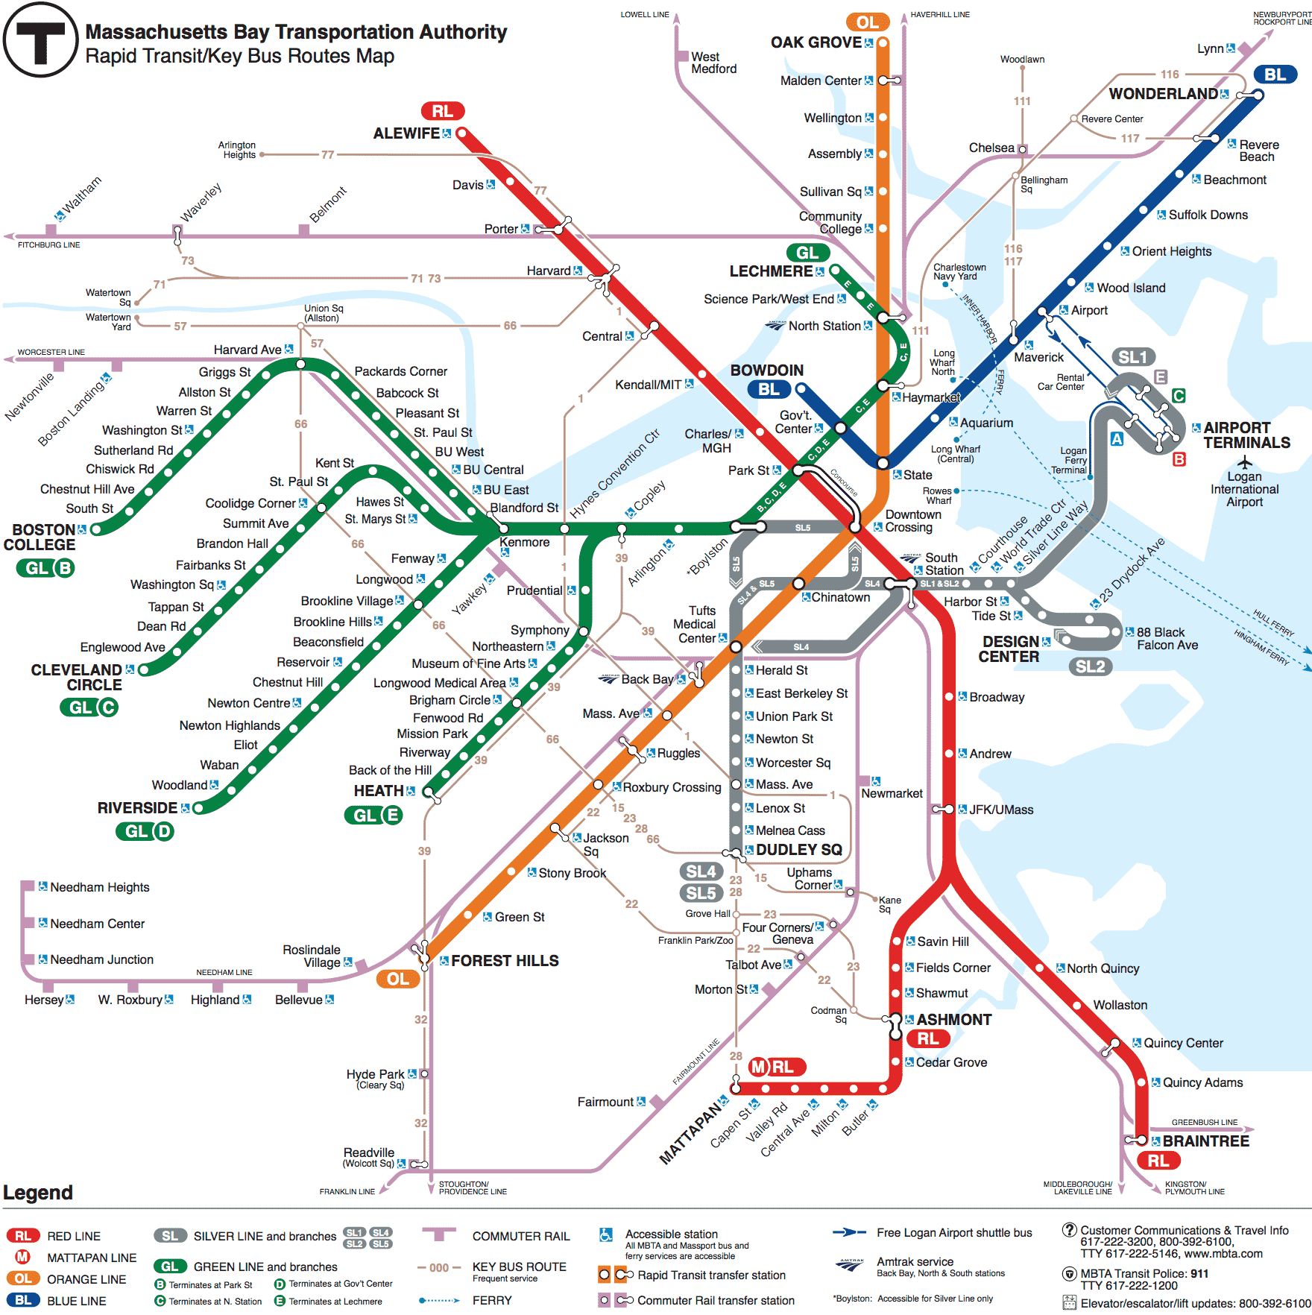
Which map of the T is more navigable?
or
Notes:
DISCUSS!
Trick question - the context matters! Who is using the map and how they’re using it will impact its clarity and navigability
What other map(s) would you need to navigate Boston as a driver? A pedestrian? A cyclist?

Slide 73
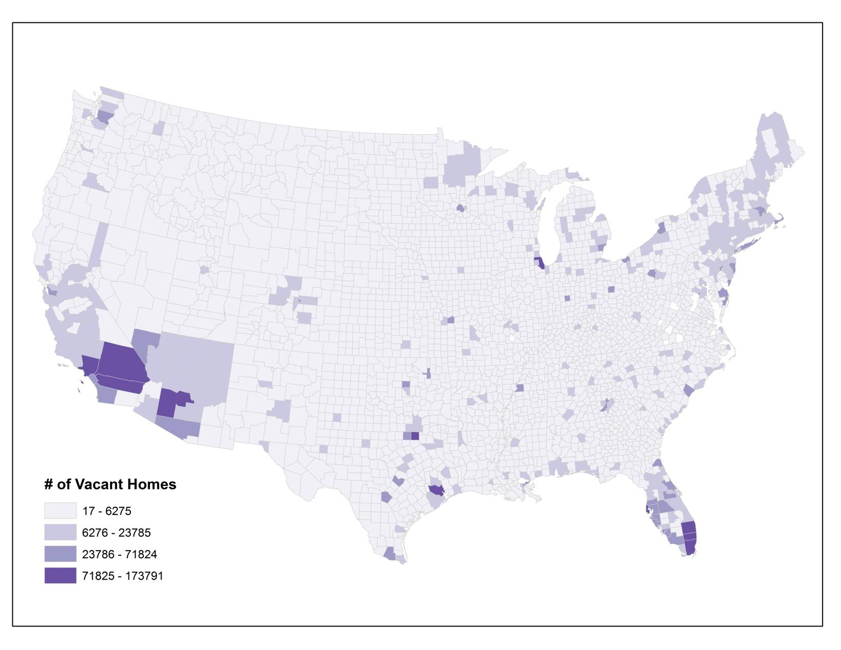
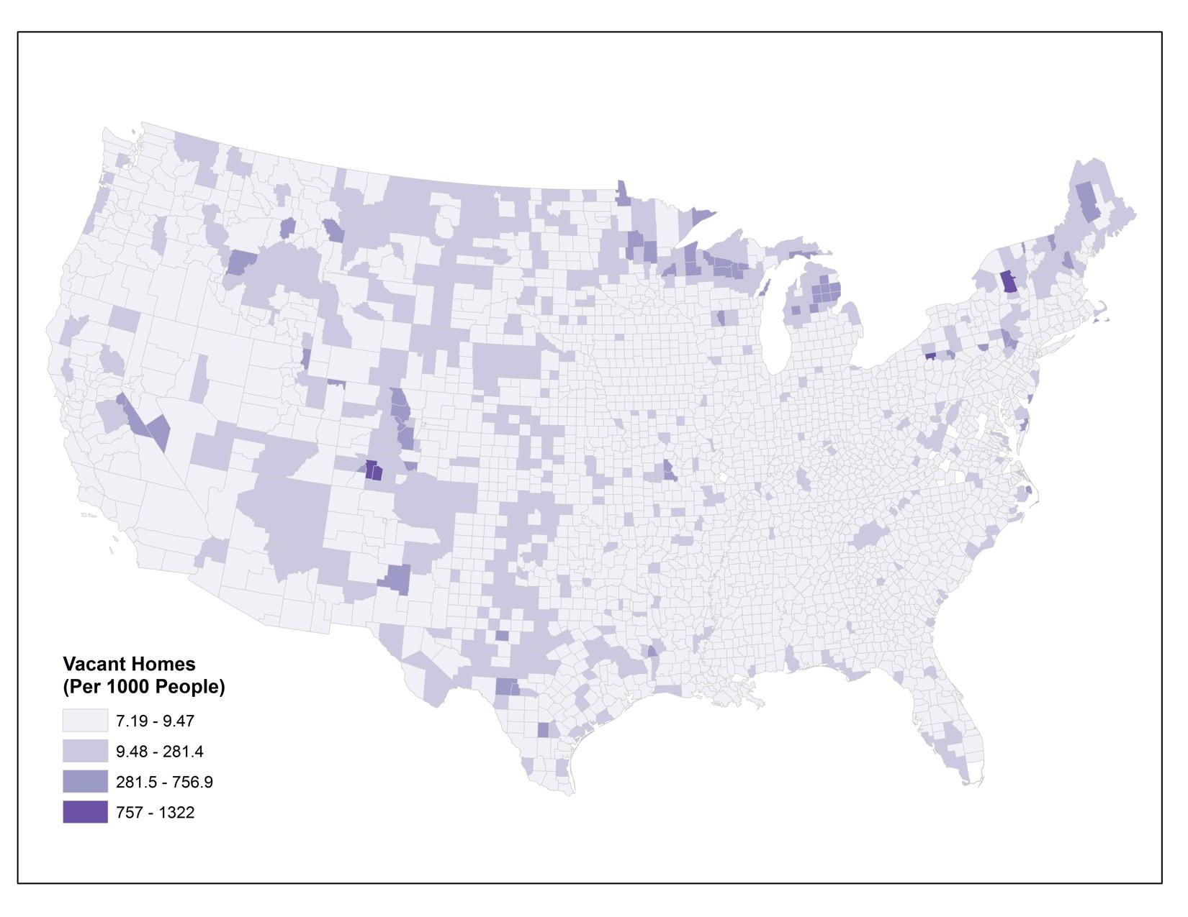
Example of Unnormalized vs. Normalized Maps
Unnormalized Map of Vacant Houses in the U.S.
Credit: U.S. Census website
Normalized Map of Vacant Houses in the U.S.
Credit: U.S. Census website
Notes:
Discuss:
What message does the unnormalized map put forth?
How is that different from the message of the normalized map?
Again, normalizing refers to adjusting data that may have been collected at different scales into a common scale.

Slide 74
Limitations of Some Data Presentation Methods: Charts and Diagrams
The structure and scale of charts and graphs could be manipulated to amplify or diminish differences
Different types of graphs and charts work better for some types of data presentation than others—for example, a pie chart and a line graph might not both be able to represent the same data accurately
A chart with too much information will be difficult to understand, but too little information could be an indication that data has been cherry-picked to support an argument

Slide 75
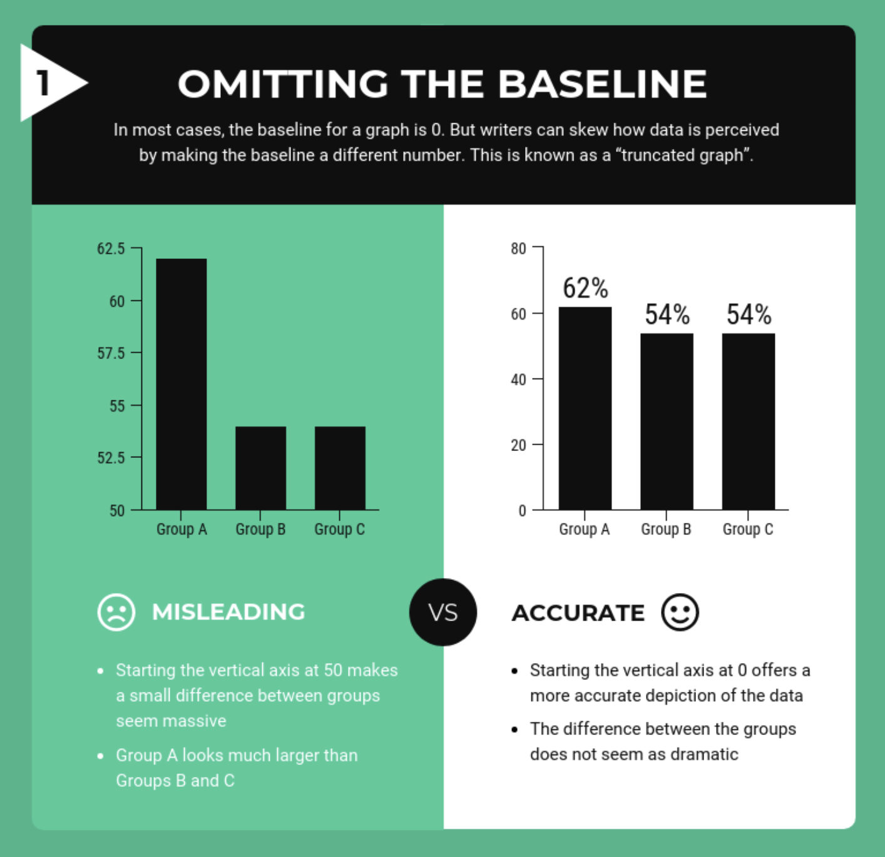
Examples of Limitations using Charts and Diagrams
Discussion:
What commonalities do you notice among the more misleading and more accurate versions of graphs and charts in these examples?
How would you define “accuracy” in the context of data presentation? Why is that question essential to ask?
In what contexts does it make the most sense to use these kinds of visuals to present data? Are there other times where they’re inappropriate? How so?
Notes:
TURN AND TALK
Take a couple of minutes with your partner(s) to look at the five examples of “misleading” and “accurate” charts and graphs (which should really be called “more misleading” and “more accurate” - this kind of data presentation is usually much more nuanced and less of a “right/wrong” binary than these visuals make it seem)
What do you notice about the “more accurate” and “more misleading” versions of the charts and graphs?
Image credits: https://venngage.com/blog/misleading-graphs/

Slide 76
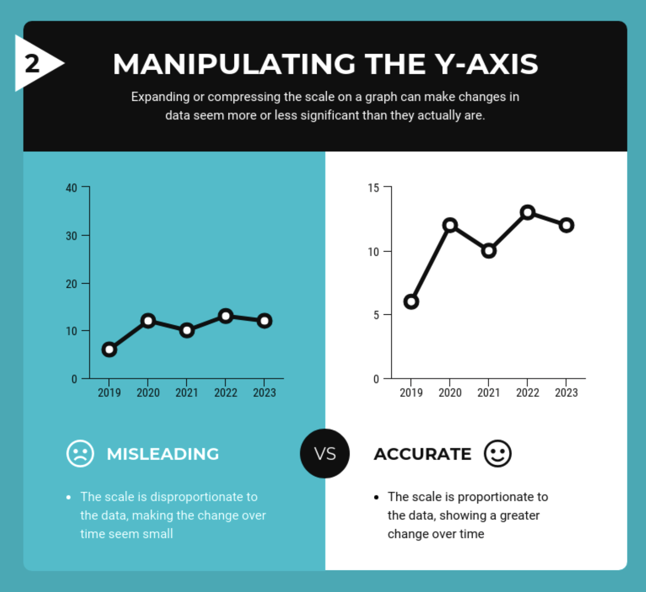
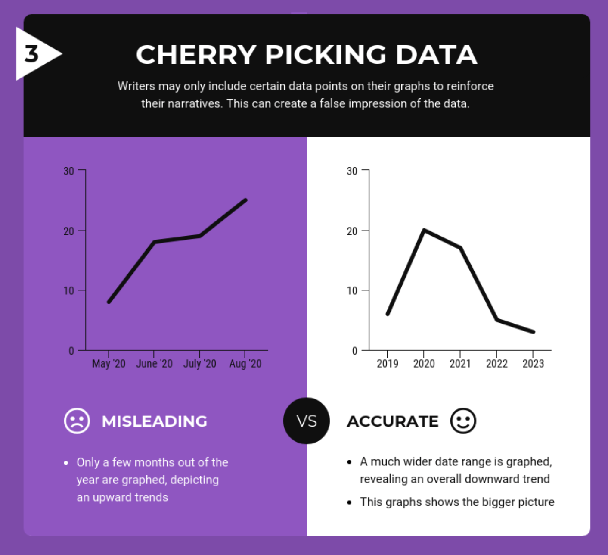
More limitations with presenting data using CHARTS and DIAGRAMS:
Notes:
TURN AND TALK
Take a couple of minutes with your partner(s) to look at the five examples of “misleading” and “accurate” charts and graphs (which should really be called “more misleading” and “more accurate” - this kind of data presentation is usually much more nuanced and less of a “right/wrong” binary than these visuals make it seem)
What do you notice about the “more accurate” and “more misleading” versions of the charts and graphs?
Image credits: https://venngage.com/blog/misleading-graphs/

Slide 77
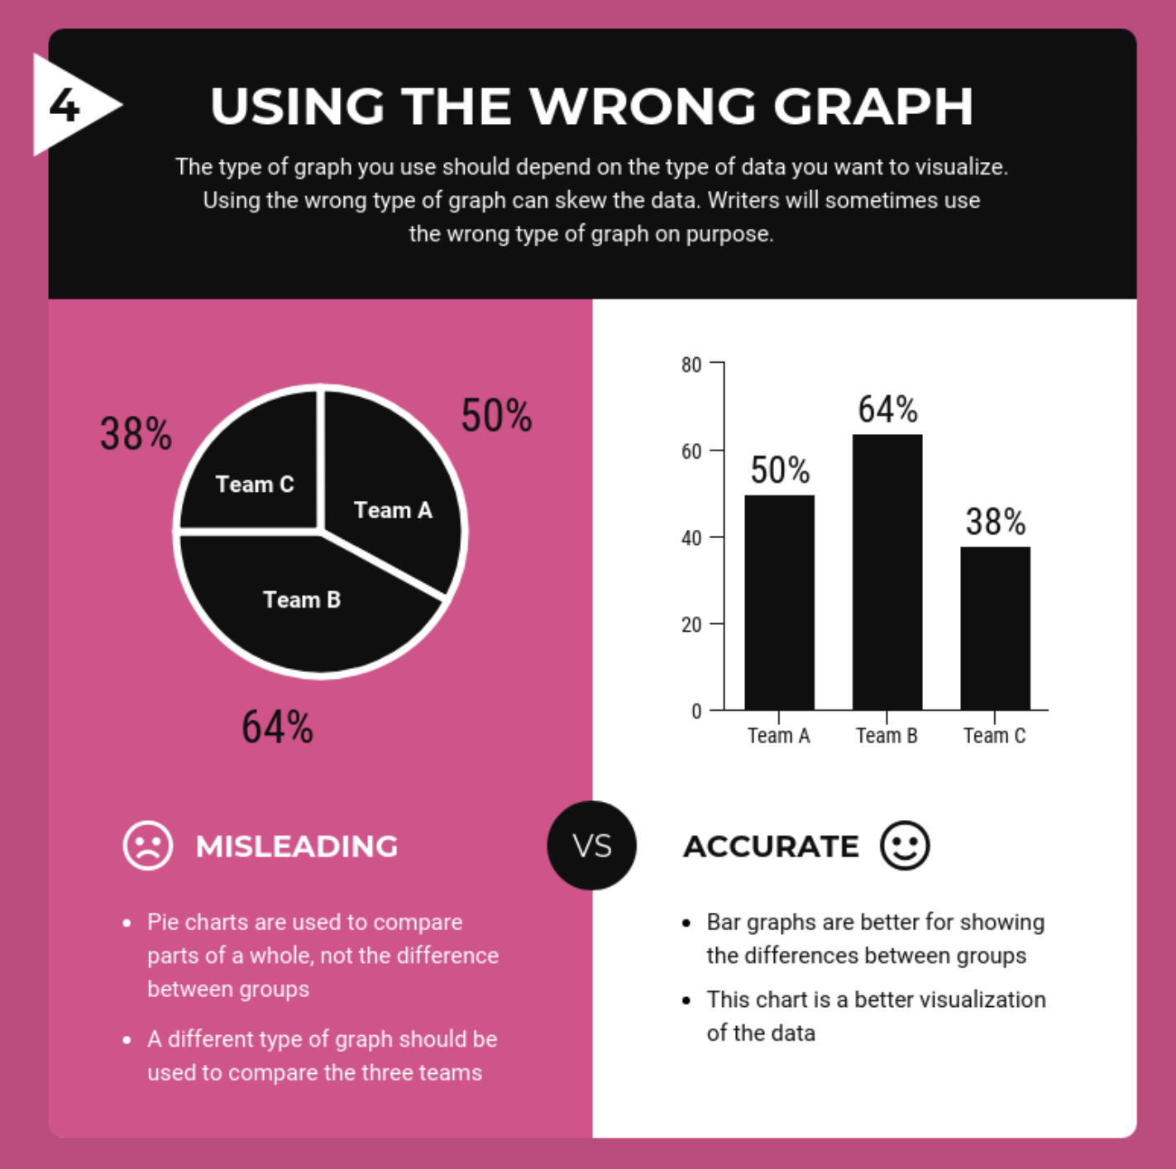
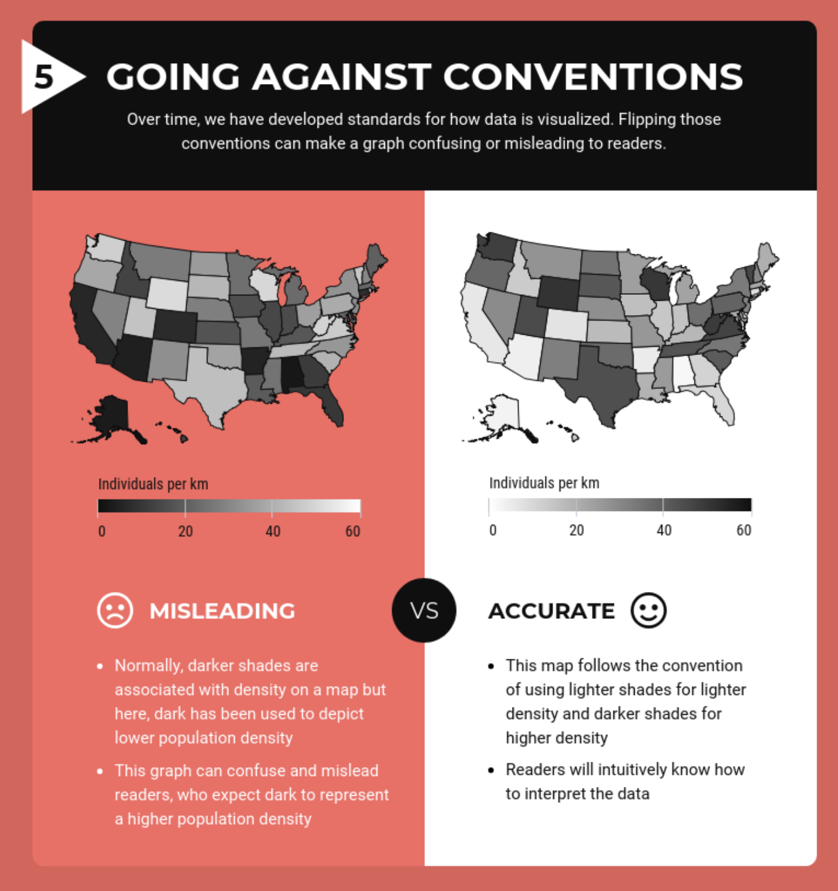
More limitations with presenting data using GRAPHS and MAPS:
Notes:
TURN AND TALK
Take a couple of minutes with your partner(s) to look at the five examples of “misleading” and “accurate” charts and graphs (which should really be called “more misleading” and “more accurate” - this kind of data presentation is usually much more nuanced and less of a “right/wrong” binary than these visuals make it seem)
What do you notice about the “more accurate” and “more misleading” versions of the charts and graphs?
Image credits: https://venngage.com/blog/misleading-graphs/

Slide 78
Moving Forward -
How can we be cognizant of ‘big data,’ algorithms, and silences in our research?
Notes:
Big data relies on collecting and categorizing information, similar to how academic research works. But, data and algorithms are solicited and designed by humans (and are thus subject to human error).
This isn’t to say that data is malicious in any way. It does, however, let us know that we can pay a bit more attention to how we engage with the world around us. We can learn to anticipate the pitfalls of big data.
As we asked questions about big data, so should we ask questions about our own research, particularly when it comes to questions about ethics, representation, and implicit biases and ideologies located in our collection and analysis process.
Even if you do not work explicitly with algorithms and machine learning, you will most likely be collecting, analyzing, and using data in some way.
What are your ethical guidelines when you do research, like when you collect, analyze, and interpret data?
THis is a writing class - so what pitfalls could you see coming up during the process of doing research and constructing a written argument?
“As multimodal writing continues to shift and expand in the era of Big Data, writing studies must confront the new challenges and possibilities emerging from data mining, data visualization, and data-driven arguments.”
“The collecting, processing, and visualizing of data—the creation of data-driven arguments—should be understood as both statistical and rhetorical in nature.”
from https://compositionforum.com/issue/37/big-data.php Aaron Beveridge, Assistant Professor of Informatics and Analytics, University of North Carolina at Greensboro
As Doug Eyman defines it in Digital Rhetoric: Theory, Method, Practice, networked writing functions as an “an ecology of circulation,” where digital networks provide a “framework that situates digital circulation within specific ecologies and economies of production
(Networked writing - hashtags, trending articles, retweets, etc.)
In Rhetorical Numbers: A Case for Quantitative Writing in the Composition Classroom, Joanna Wolfe explains that “there is a paradox in that on one hand our culture tends to represent statistical evidence as a type of 'fact' and therefore immune to the arts of rhetoric, but on the other hand we are deeply aware and suspicious of the ability of statistics to be 'cooked,' 'massaged,' 'spun,' or otherwise manipulated.”

Slide 79
Questions Researchers Must Ask
What information is being collected and from where? To whom does this data belong?
How is it being collected? Do participants know that it is collected, how it will be collected, and how will it be used?
How will the data be analyzed? What biases and ideologies may be implicit in this analysis?
Who will this research impact? Who will it benefit? Who will it potentially harm?
Notes:
ASK STUDENTS for other questions they might ask, in the context of their research project
Big data relies on collecting and categorizing information, similar to how academic research works. As we asked questions about big data, so should we ask questions about our own research, particularly when it comes to questions about ethics, representation, and implicit biases and ideologies located in our collection process
What information is being collected and from where? To whom does this data belong?
How is it being collected? Do participants know that it is collected, how it will be collected, and how will it be used?
How will the data be analyzed? What biases and ideologies may be implicit in this analysis?
Who will this collection impact? Who will it benefit? Who will it potentially harm?

Slide 80
Responsibly Using Big (or any kind of) Data
Be thoughtful and intentional as you incorporate big data or conclusions drawn from big data sources in your work—think:
Could this evidence be interpreted in a different way?
Is this the strongest evidence I could use to support my claim?
Is the way I’m presenting this information accurate, or could it be considered in any way misleading?
Notes:
Citing big data sources
How was the data collected, by and from whom, and what conclusions have been drawn from it by you and by others?
The idea of provenance - tracing the chronology of ownership or stewardship of information
Keeping track of and sharing your methodology

Slide 81
Responsibly Using Big (or any kind of) Data
When reading, evaluating, and citing the work of others, be data-literate:
turn a critical eye to studies that use big data
evaluate the sources of that data
carefully examine the conclusions authors draw from their sources
Notes:
Citing big data sources
How was the data collected, by and from whom, and what conclusions have been drawn from it by you and by others?
The idea of provenance - tracing the chronology of ownership or stewardship of information
Keeping track of and sharing your methodology

Slide 82
Sources are important!
The inherent intertextuality of academic writing is important for us to remember as we begin to plan and execute research projects.
So much academic work involves weaving together multiple texts, synthesizing the work of others and using it to frame or support your argument - the way you use and analyze the work of others is key!
Much of your work will probably involve using sources published in academic books and journals, or primary sources from archives, but non-traditional and non-academic sources could pay an important role in your work, too.
In your own work you can address silences and gaps in scholarship by seeking a variety of traditional and non-traditional sources to support your argument or narrative, and amplify voices that are heard less often.

Slide 83
Finding and Using Non-Traditional Sources
Some kinds of non-traditional and/or non-academic sources:
Public Media (written/broadcast journalism)
Crowdsourced projects (including wikipedia, aggregate reviews, etc.)
Multimedia sources (including social media and blog posts)
Using Twitter for academic research
Prof. Eunsong Kim’s The Politics of Trending
Oral histories and interviews
Indigenous forms of knowledge
Notes:
Each of the example types of sources on this slide has a link to a source you might find helpful (for Public Media it’s the homepage for American Public Media), to an article about using that type of source in academic work, or a guide to ethical use of that source in academia
What are some other types of non-traditional or non-academic sources you might use for your project for this class?

Slide 84
Vetting and Citing Non-Traditional Sources
Regardless of the type of source you’re using, but especially if it isn’t coming from an academic publication, you should always...
Try to verify the information presented in the source by finding other (independent) sources that support it
Be clear in your writing about what kind of source it is, where you found it, and how you’re using it (be explicit about your process and the source’s purpose)
Cite your source appropriately so that any reader can find it
Citing non-traditional sources correctly: Purdue Online Writing Lab (OWL)
Notes:
LAST CONTENT SLIDE
If your source seems fishy or their argument or evidence are flimsy, do some more digging
Remember, lots of entities (companies, governments, individuals) pay for research to be done that supports their work or specific outcomes, and pay for publicity that puts their work in a positive light
So look at WHO is publishing articles, charts, or infographics, and think critically about WHY they may be doing so
Be transparent about your methodologies - even to the point where you describe your research process, including what your sources are and how you found and decided to use them
In projects that use Big Data (or any data sets), the authors often include methodological essays that discuss the data gathering, organizing, and cleaning process, and speak directly to gaps in the data and how those gaps could skew results
Cite your source appropriately so that any reader can find it
Use the Purdue OWL to help you determine how to cite nontraditional sources in your writing, or schedule an appointment at the Northeastern Writing Center {https://cssh.northeastern.edu/writingcenter/}
https://journals.sagepub.com/doi/full/10.1177/1747016116650720 research example of researchers trying to inform members of an online forum that researchers were present

Slide 85
Thank you!
If you have any questions, contact DITI at nulab.info@gmail.com
Developed by DITI Research Fellows:
Tieanna Graphenreed, Vaishali Kushwaha, Cara Messina, Yana Mommadova, Garrett Morrow, Colleen Nugent, Milan Scobic, and Claire Tratnyek, with help from BARI Data Specialist Shunan You
Slides, handouts, and data available at https://bit.ly/3Q991EG
Schedule an appointment with us! https://calendly.com/diti-nu

